Slide 1
Module 12
AI API Integrations

Slide 2
• Introduction to AI APIs
• Understanding Gemini API Concepts
• Prompt Engineering Basics
• Configuring Gemini in the Node.js Backend
• Building the AI Service Layer
• Creating Prompt Templates
• Building AI API Endpoints
• Connecting the React Frontend
• Testing the Complete AI Toolkit
• Key Takeaways

Slide 3
Introduction to AI APIs

Slide 4
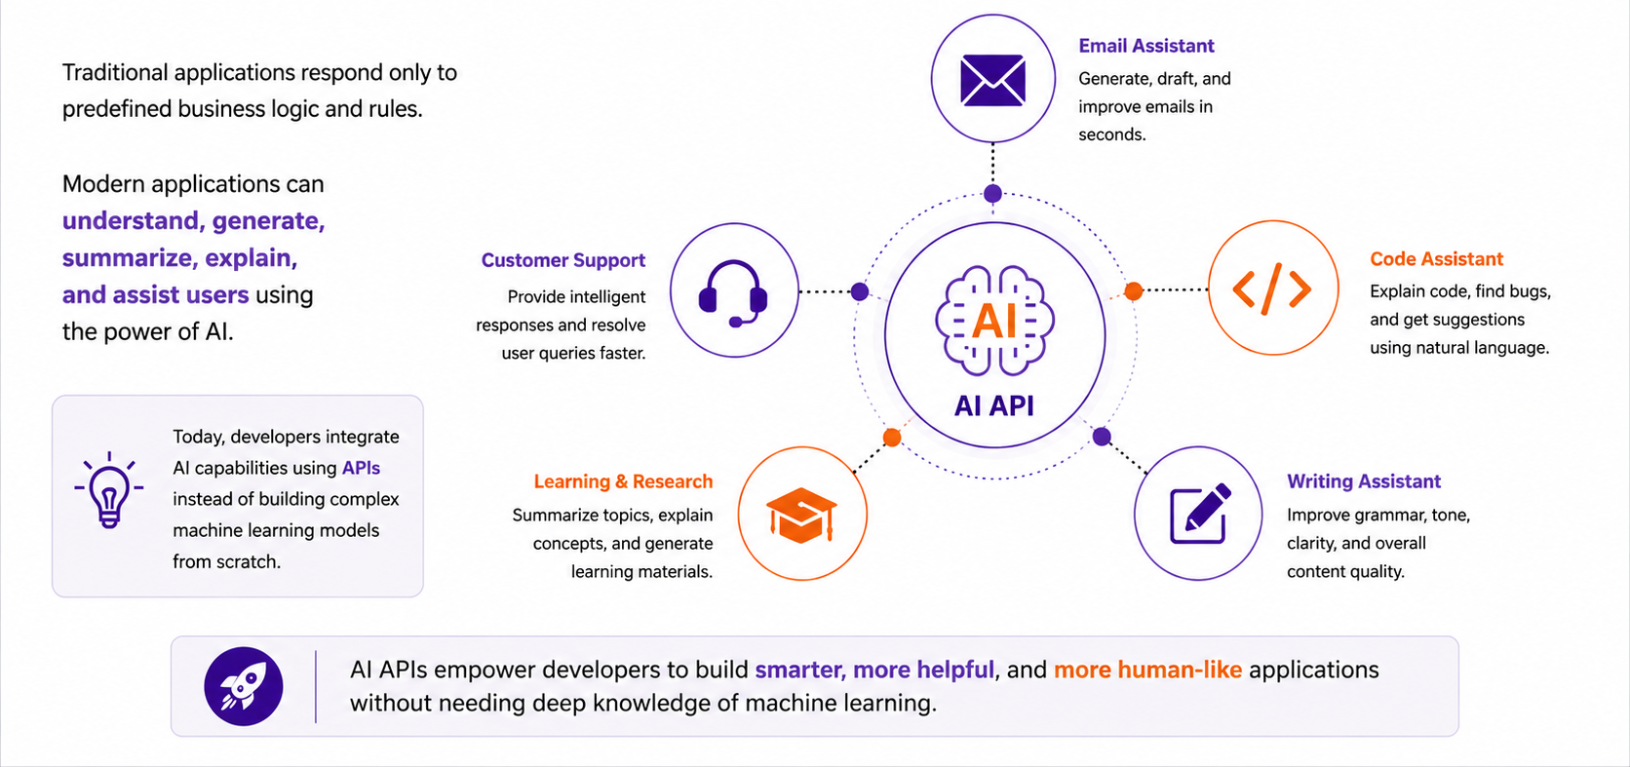
Why Do Modern Applications Need AI?

Slide 5
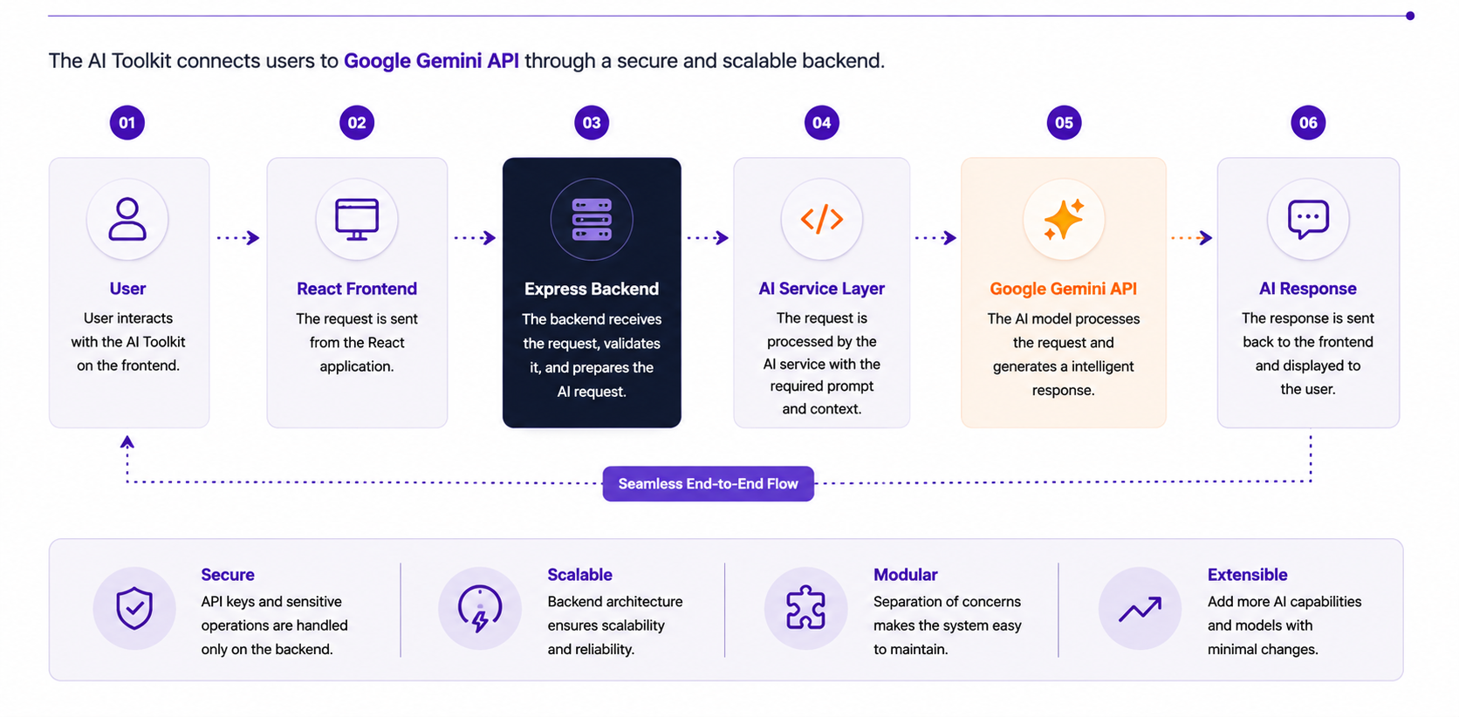
How AI Integration Works

Slide 6
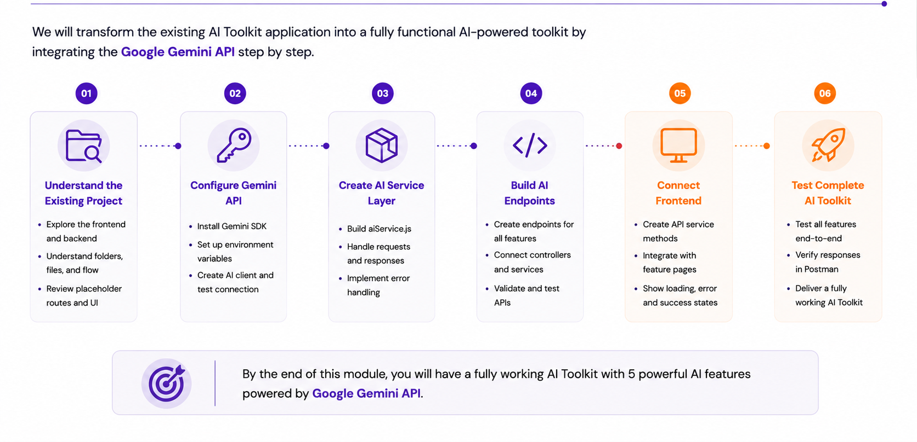
What Will We Build in This Module?

Slide 7
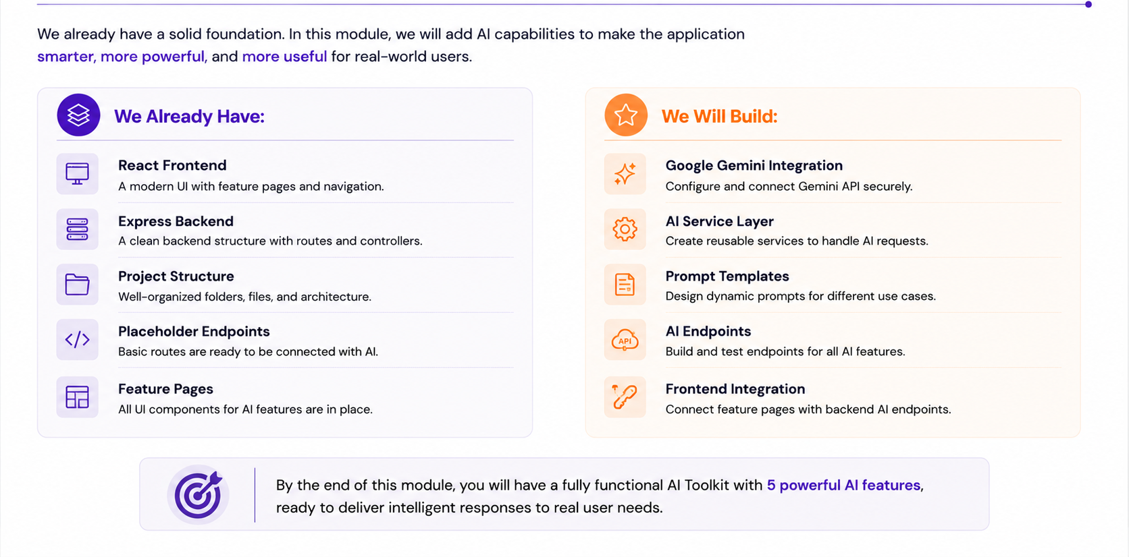
Before We Begin

Slide 8
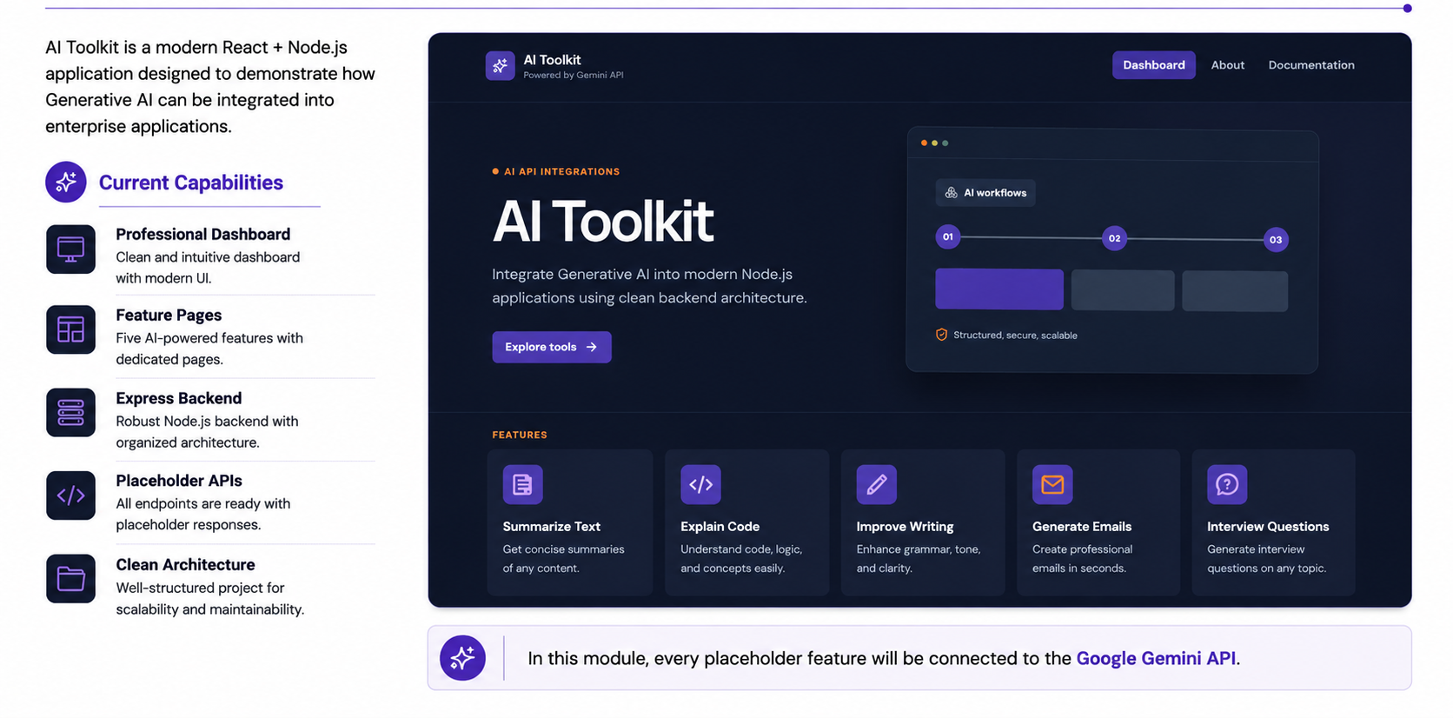
Meet the AI Toolkit Application

Slide 9
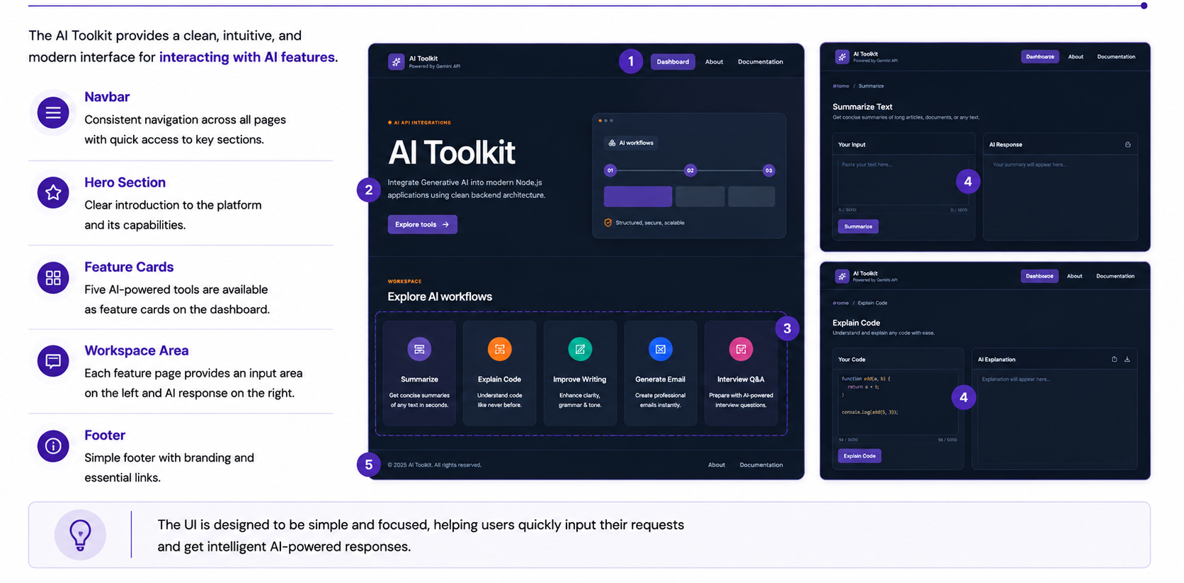
Exploring the User Interface

Slide 10
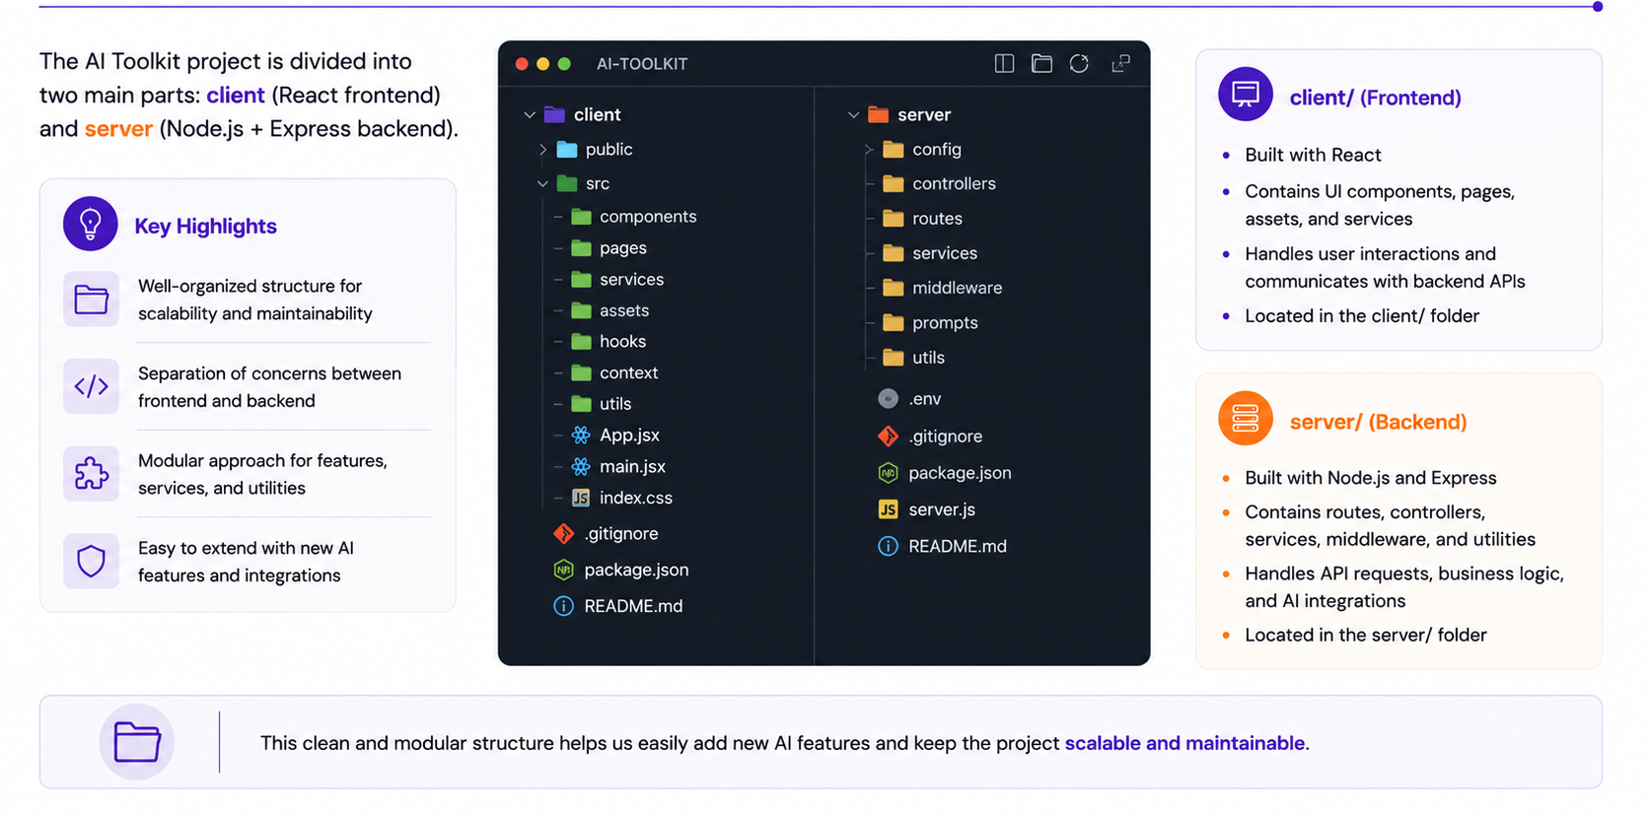
AI Toolkit Folder Structure

Slide 11
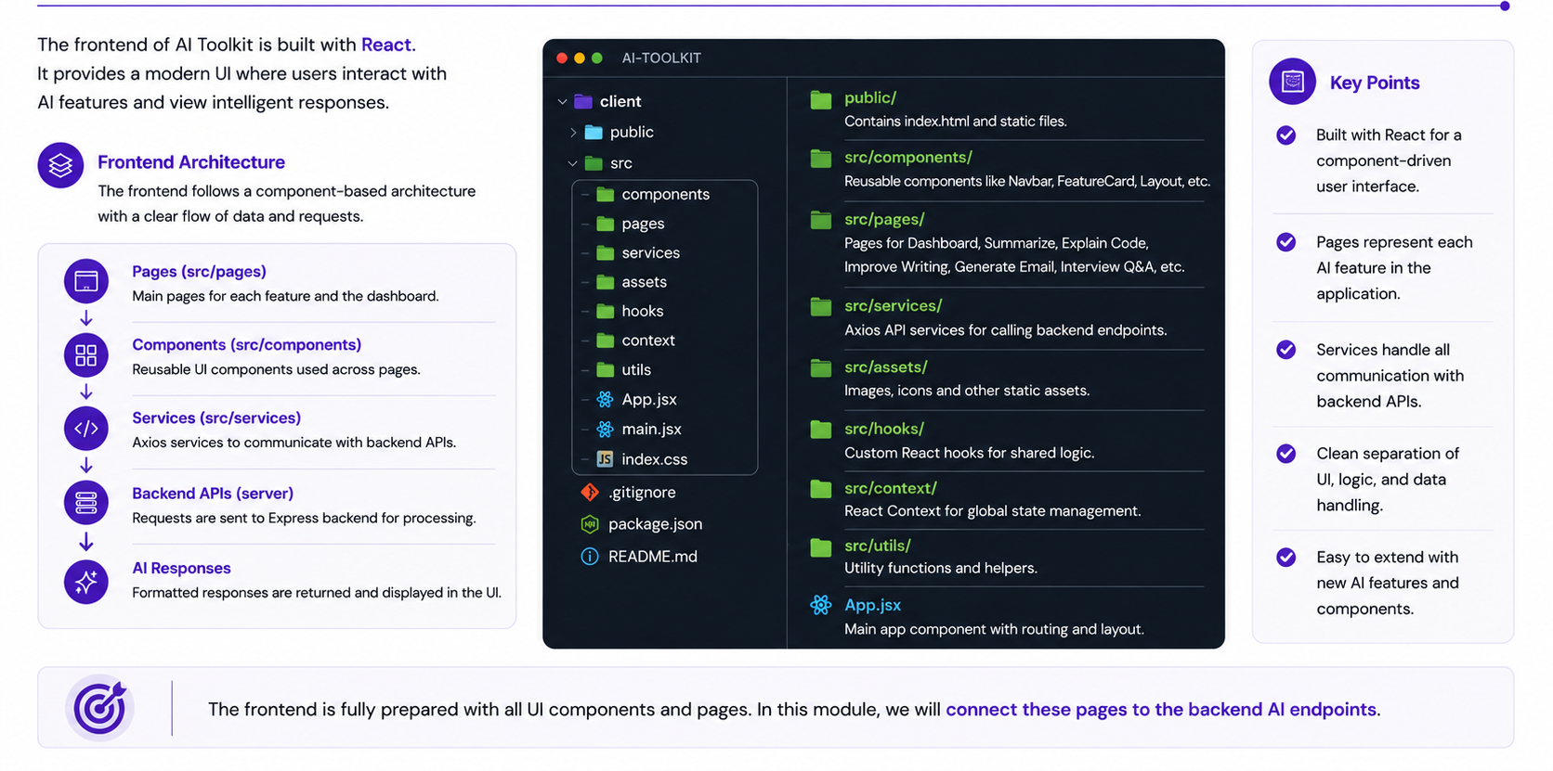
Understanding the Frontend

Slide 12
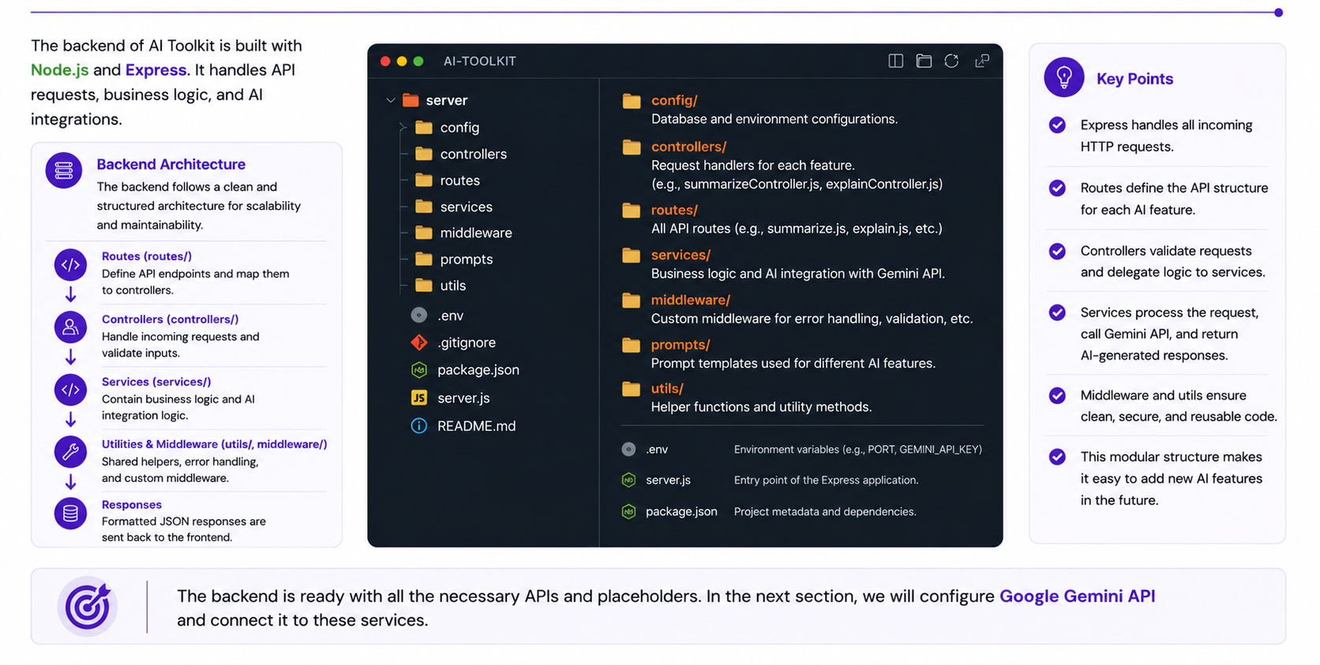
Understanding the Backend

Slide 13
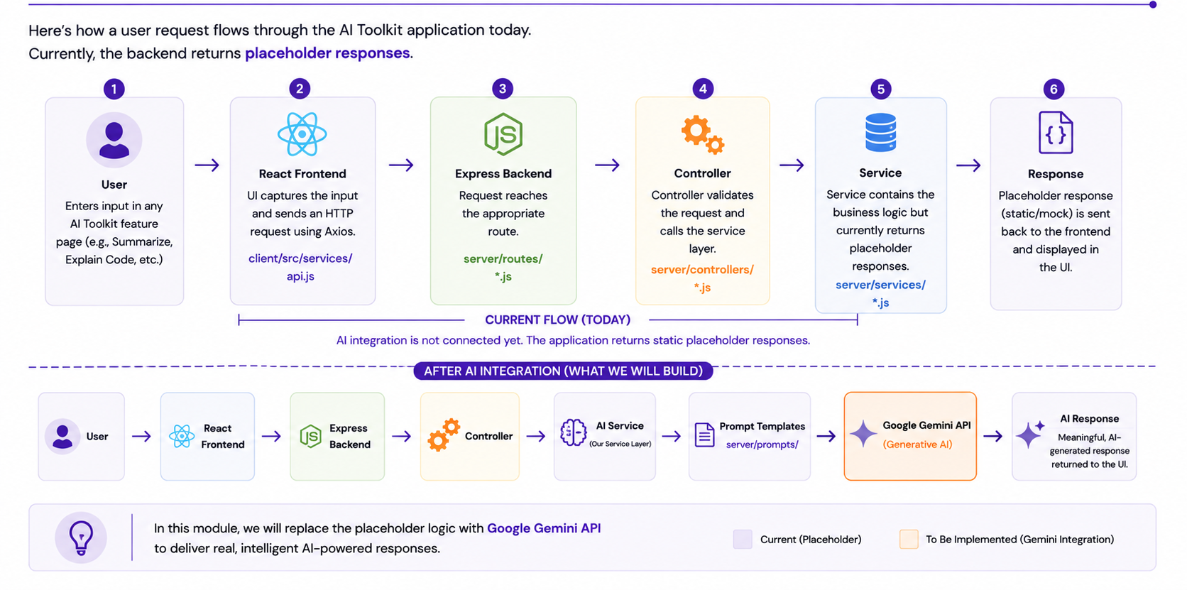
Existing Application Flow

Slide 14
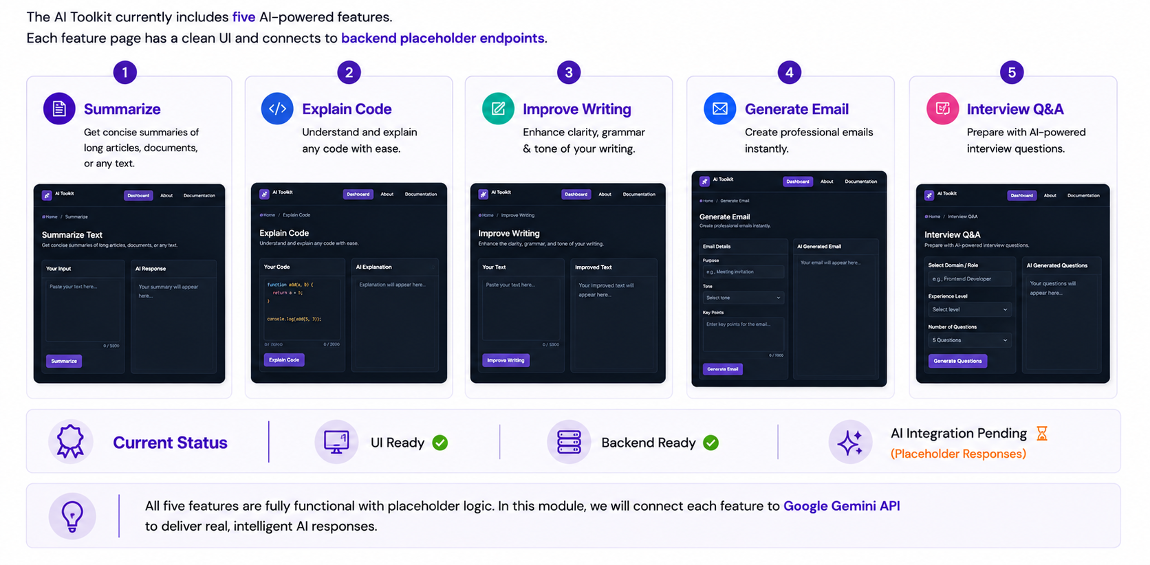
Current AI Feature Pages

Slide 15
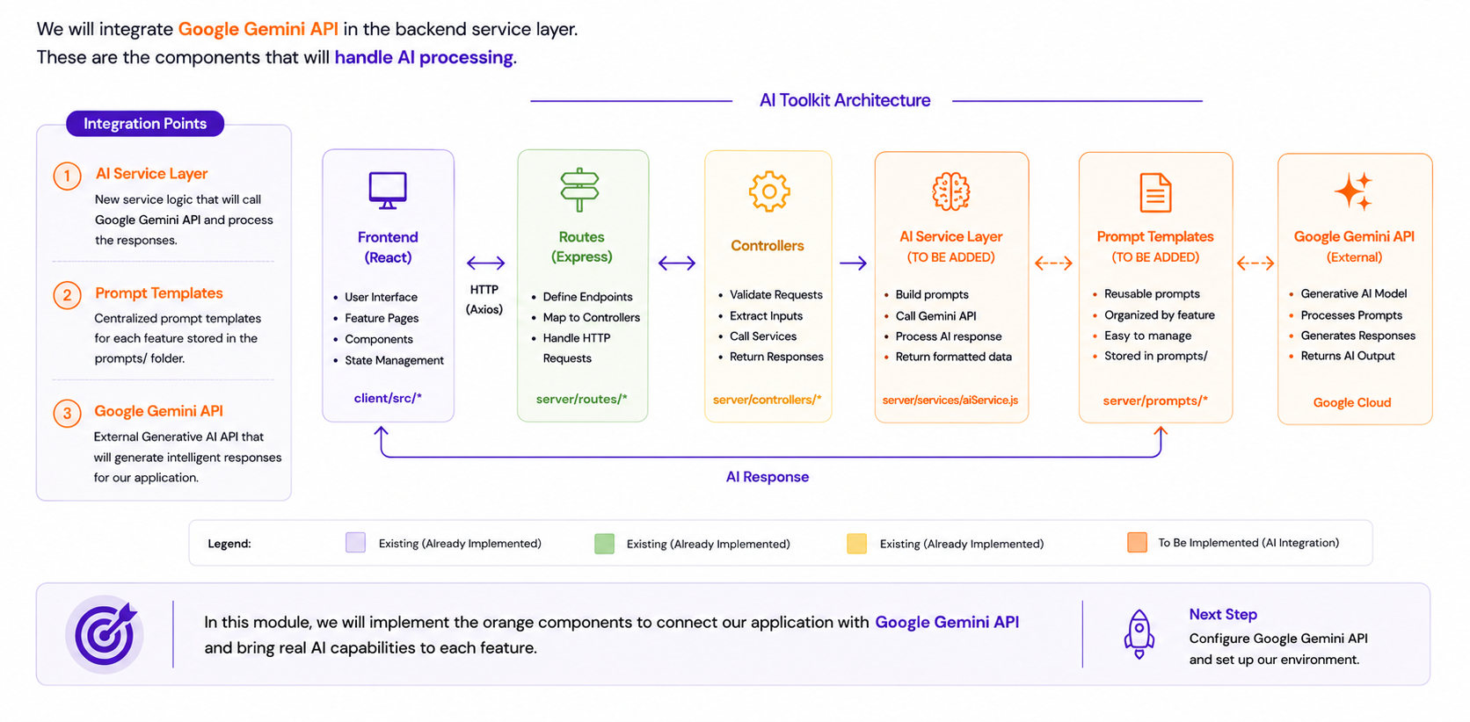
Where Will AI Be Added?

Slide 16
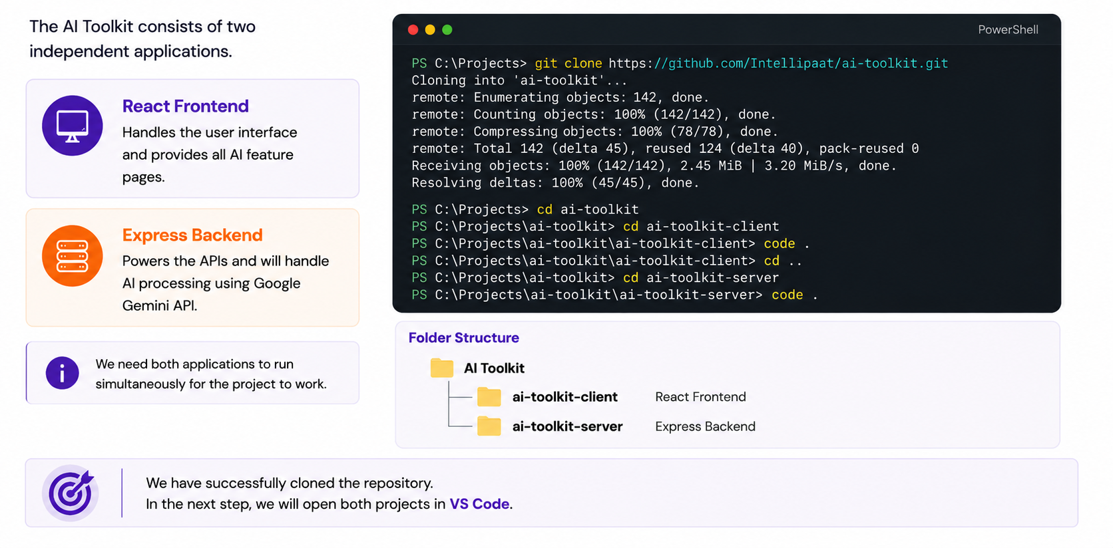
Clone the AI Toolkit Repository

Slide 17
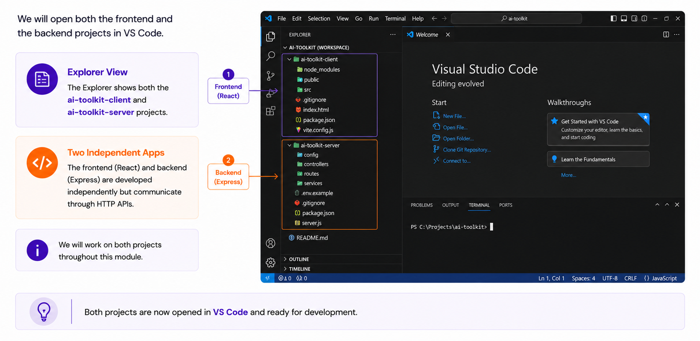
Opening the Project in VS Code

Slide 18
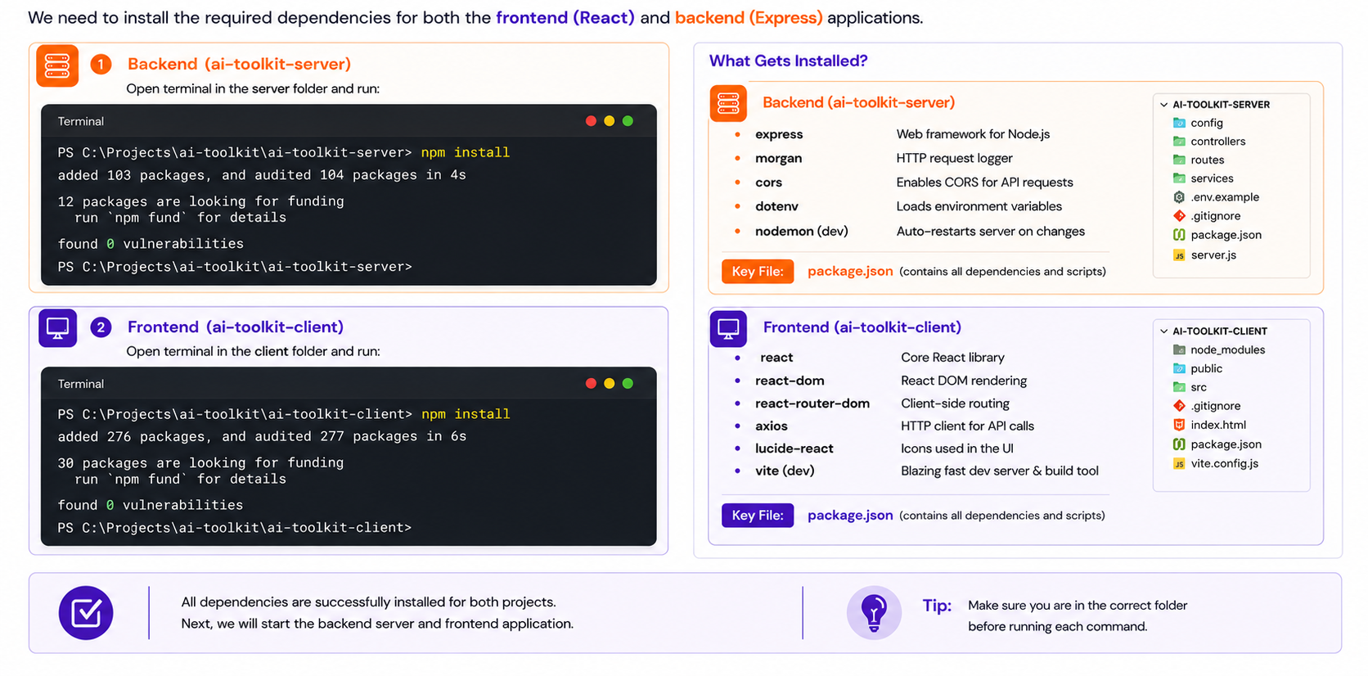
Installing Project Dependencies

Slide 19
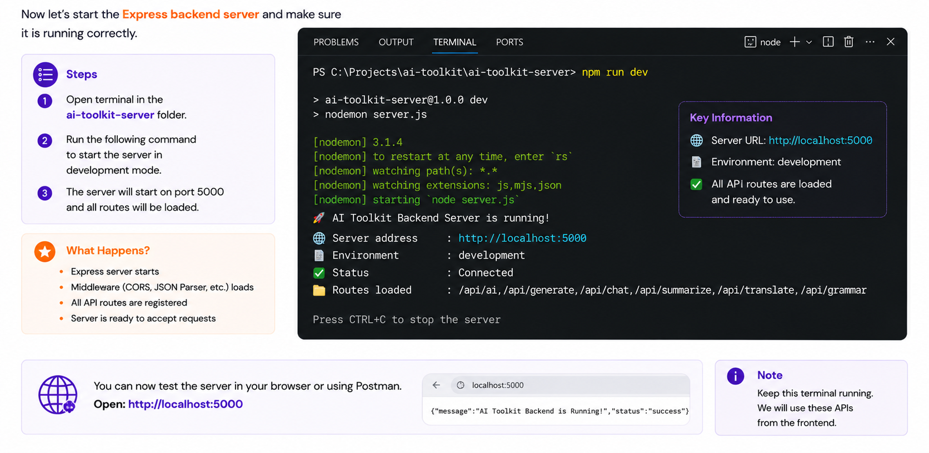
Running the Backend Server

Slide 20
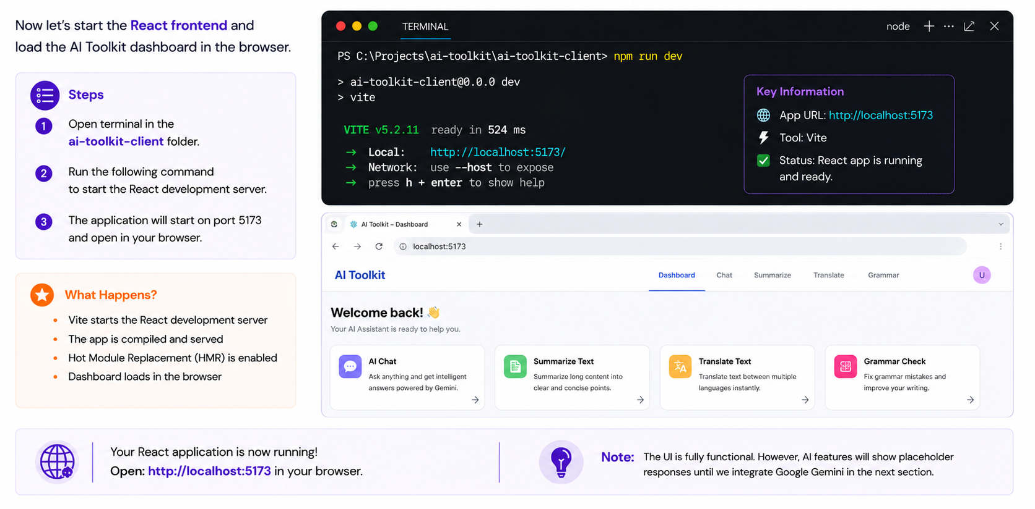
Running the React Application

Slide 21
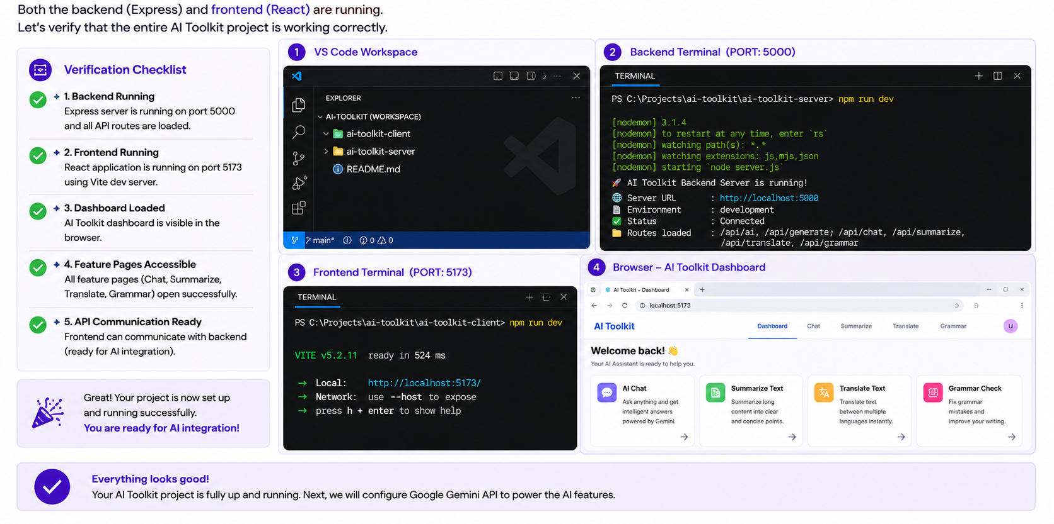
Verifying the Complete Project

Slide 22
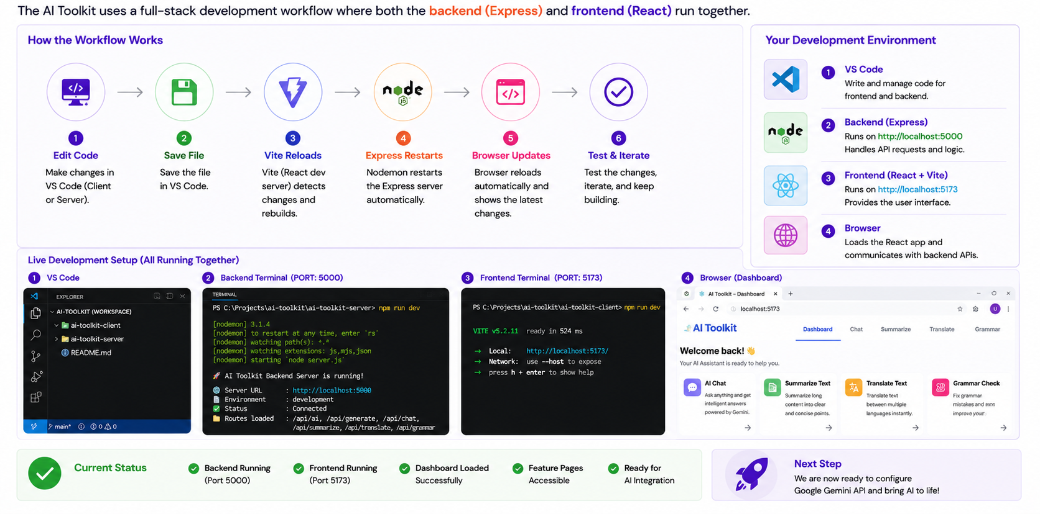
Understanding the Development Workflow

Slide 23
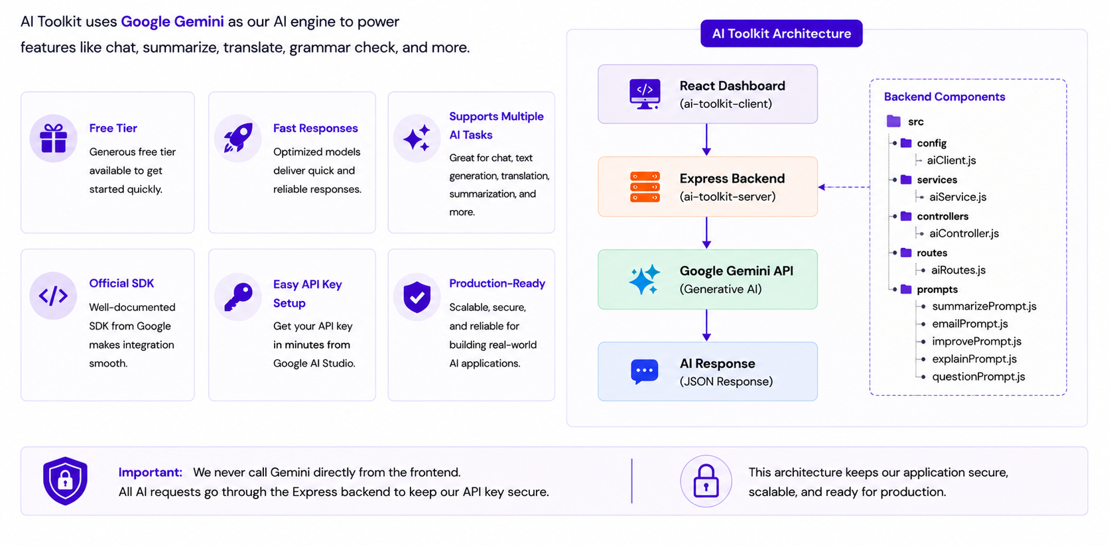
Why Google Gemini?

Slide 24
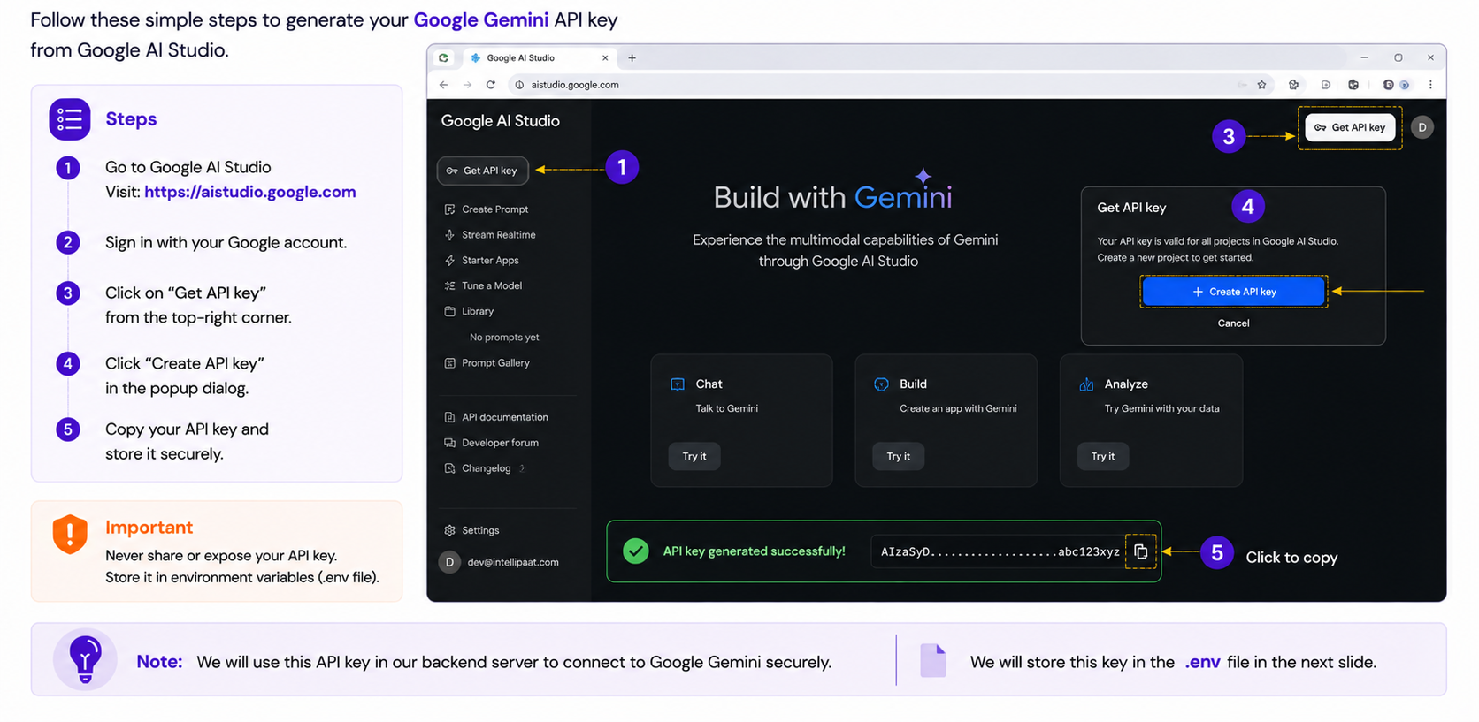
Creating a Gemini API Key

Slide 25
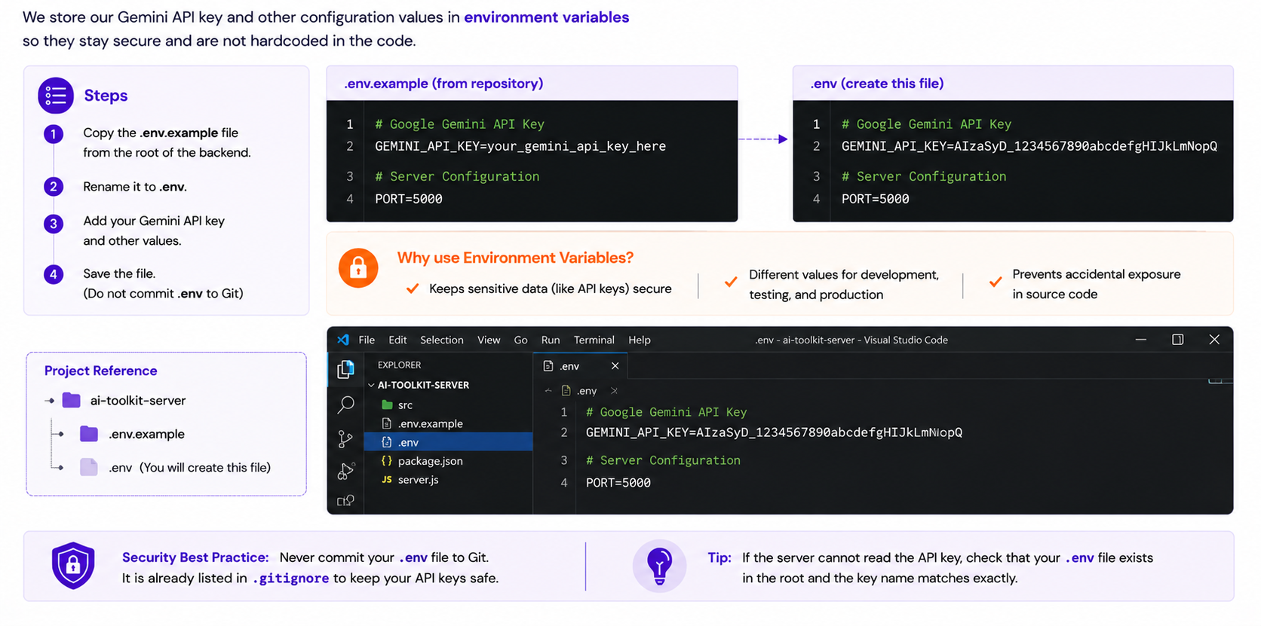
Configuring Environment Variables

Slide 26
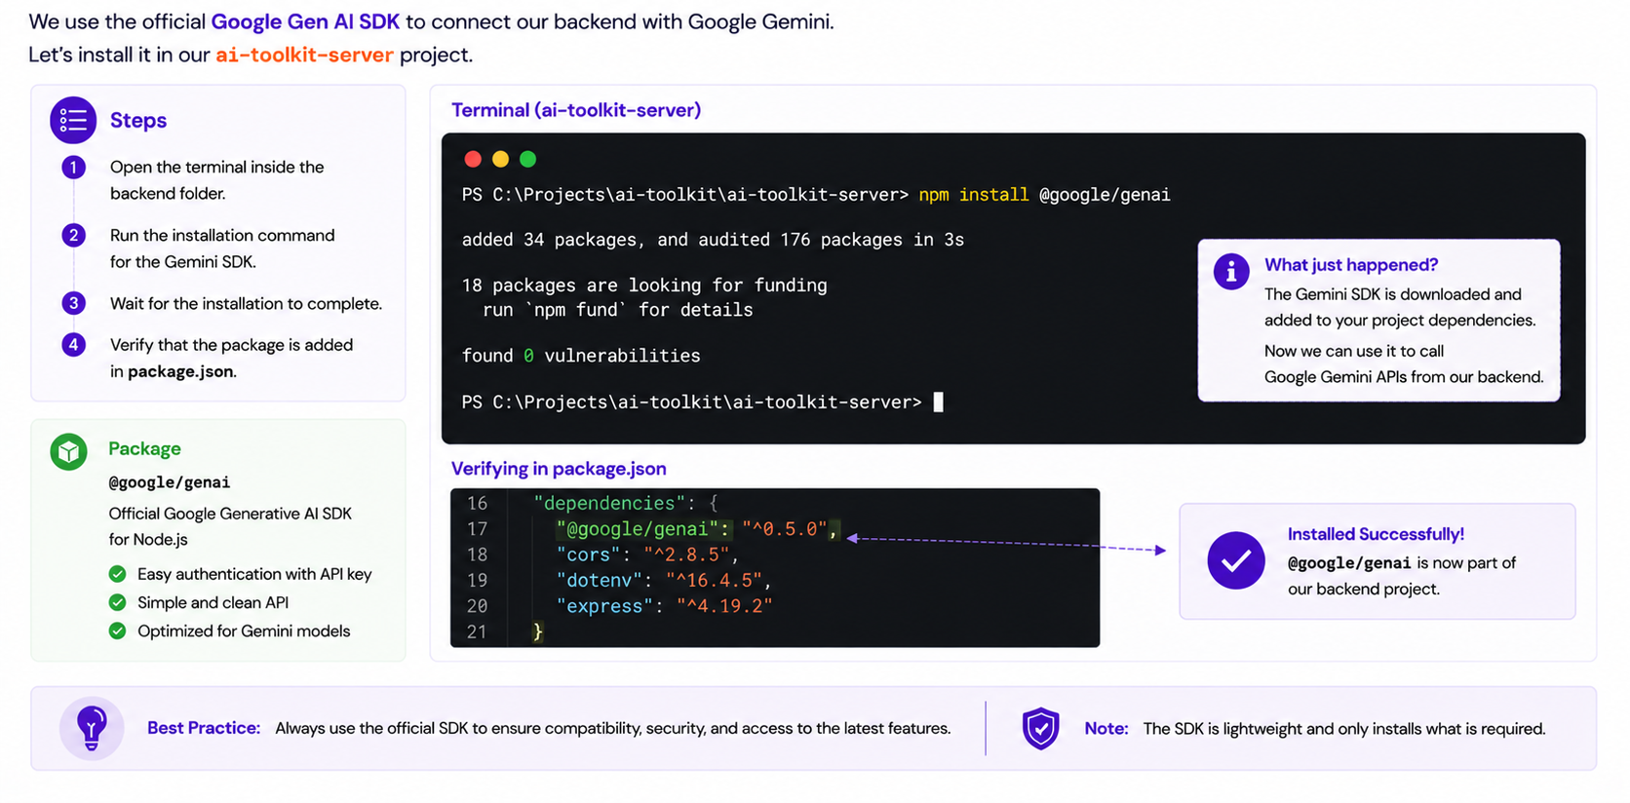
Installing the Gemini SDK

Slide 27
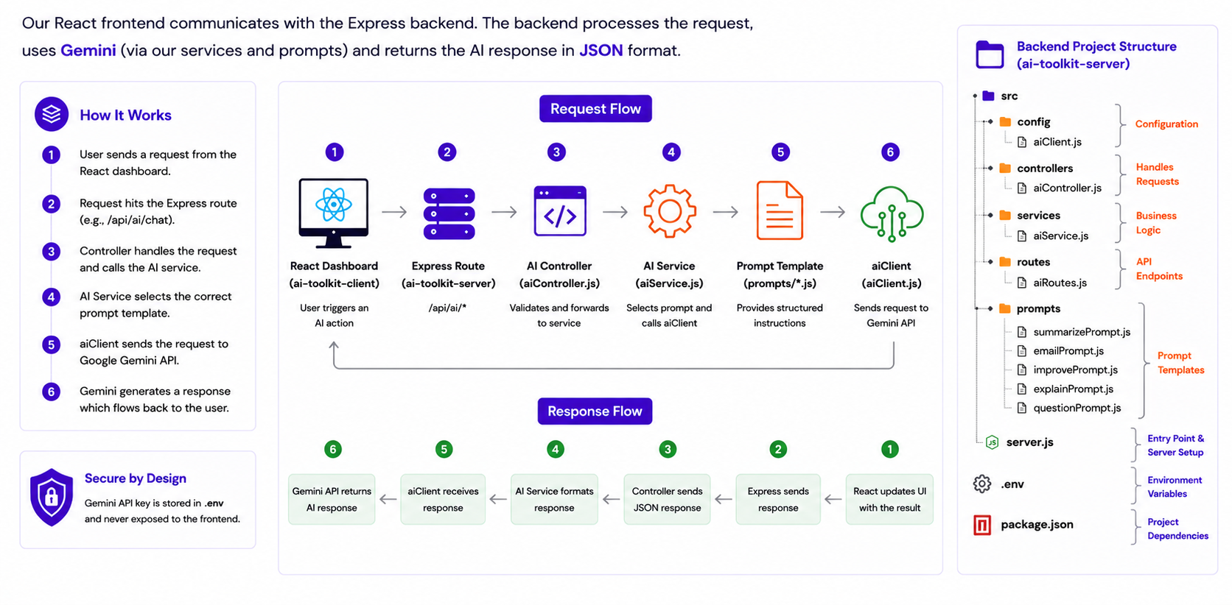
Understanding the AI Integration Architecture

Slide 28
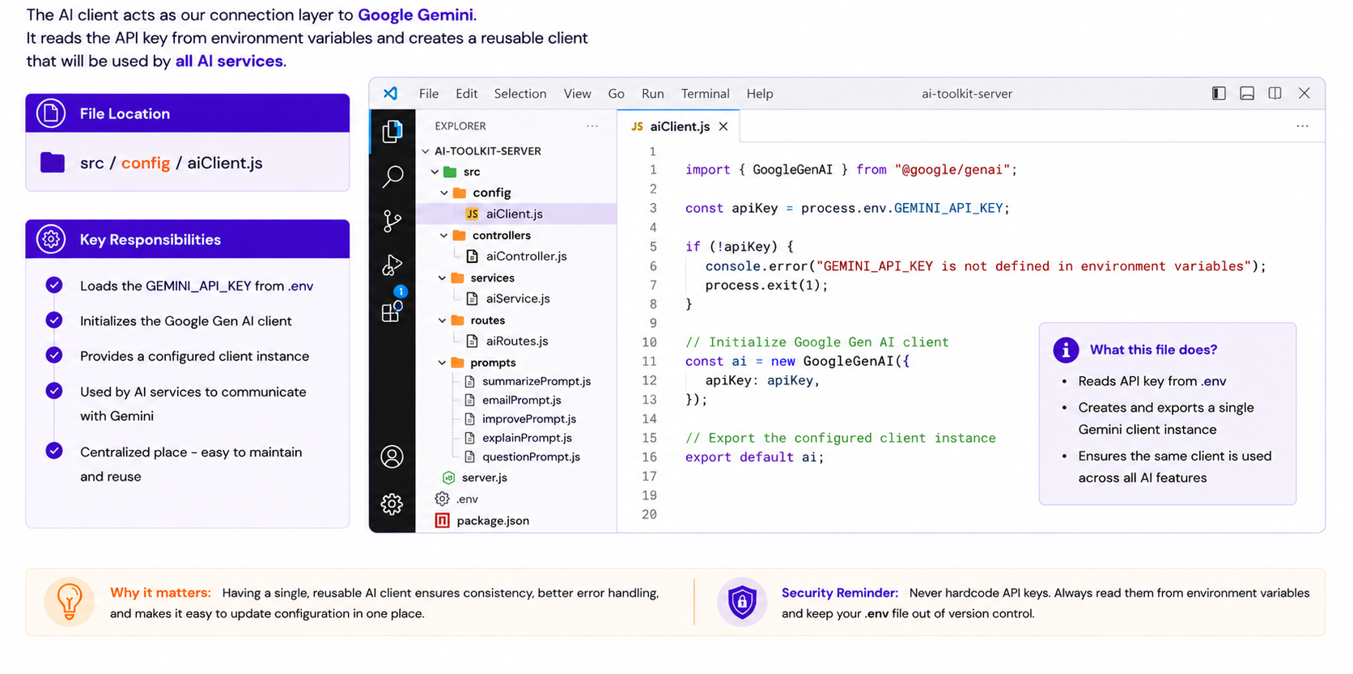
Exploring geminiClient.js

Slide 29
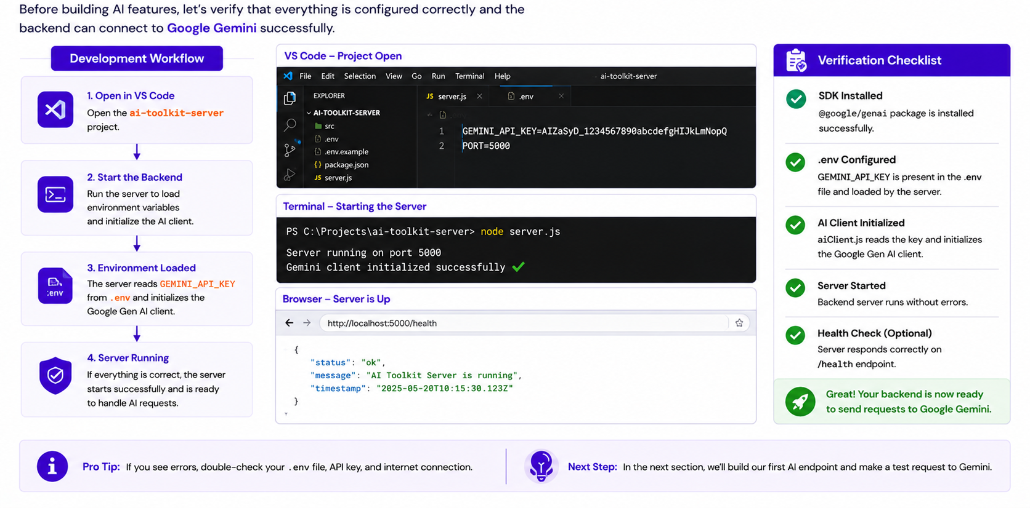
Verifying Gemini Configuration

Slide 30
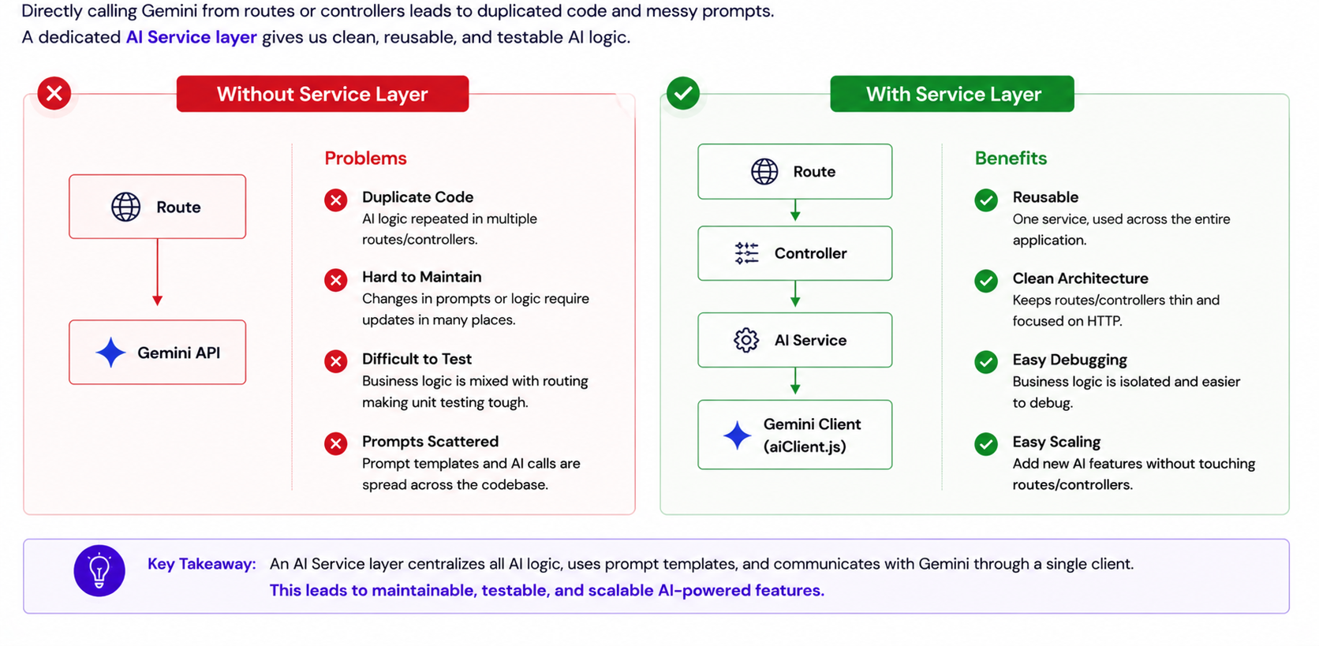
Why Do We Need an AI Service Layer?

Slide 31
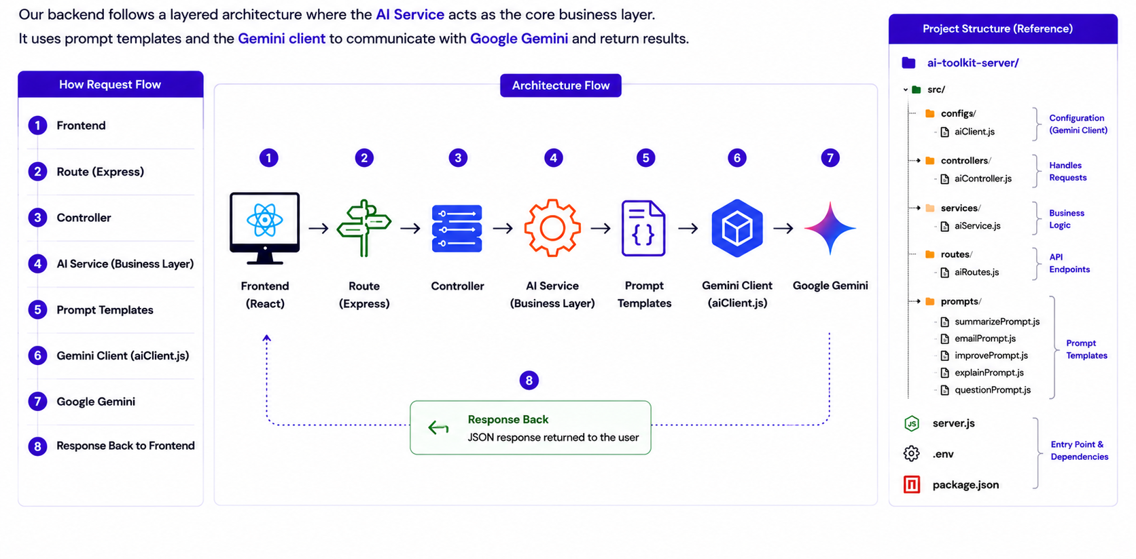
Understanding the AI Service Architecture

Slide 32
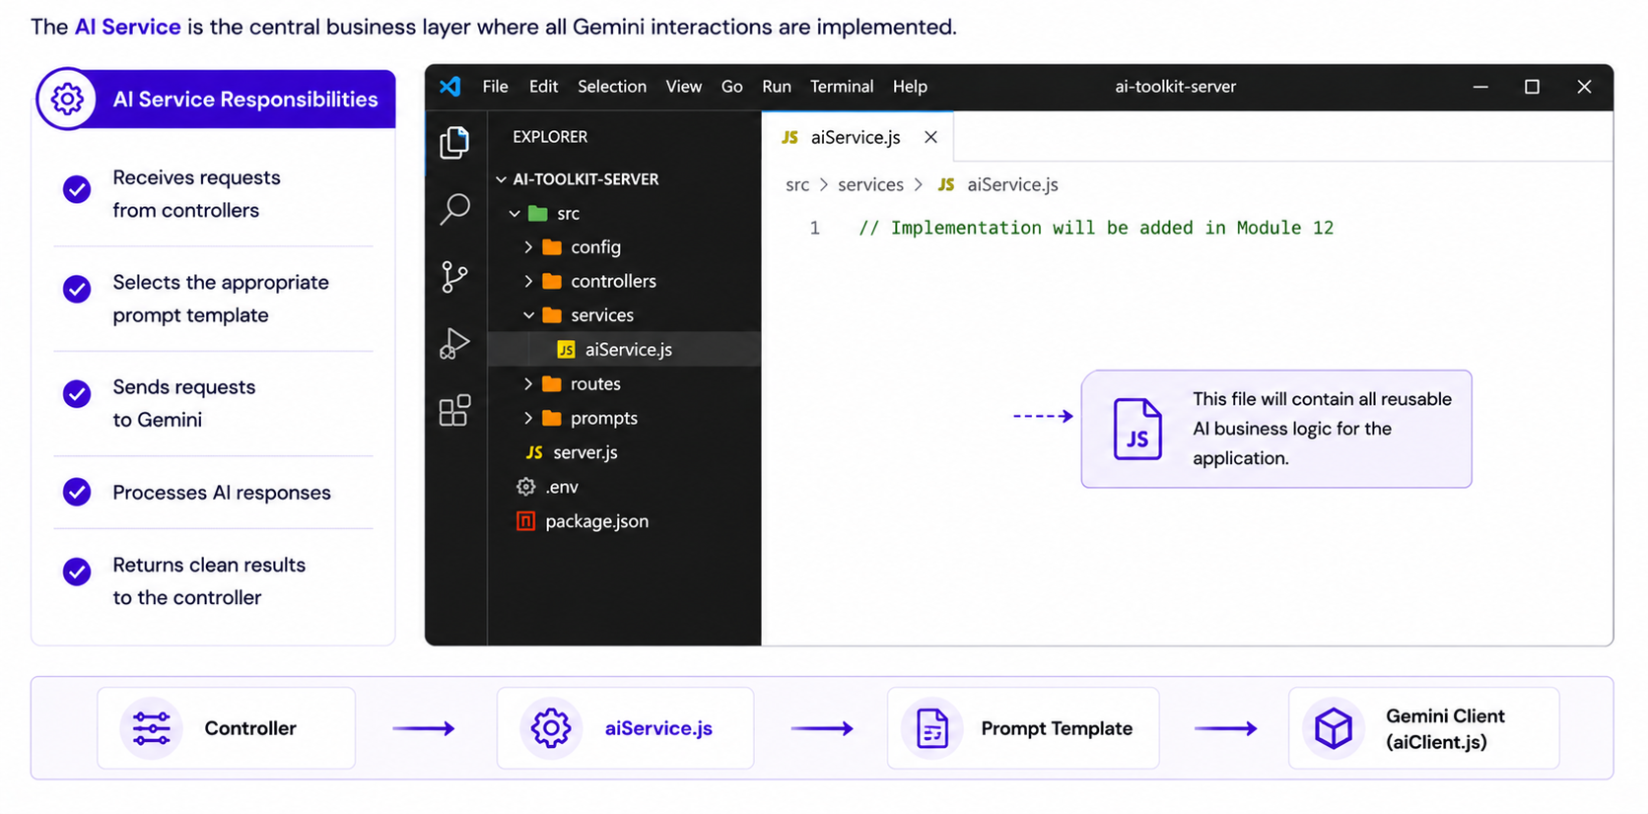
Exploring aiService.js

Slide 33
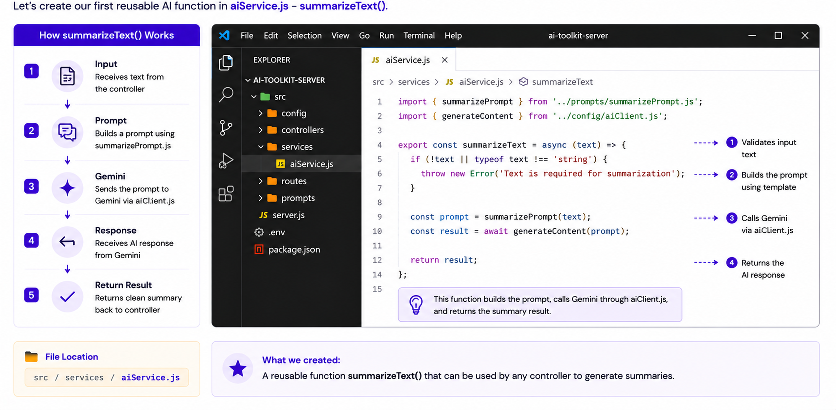
Creating Our First AI Function

Slide 34
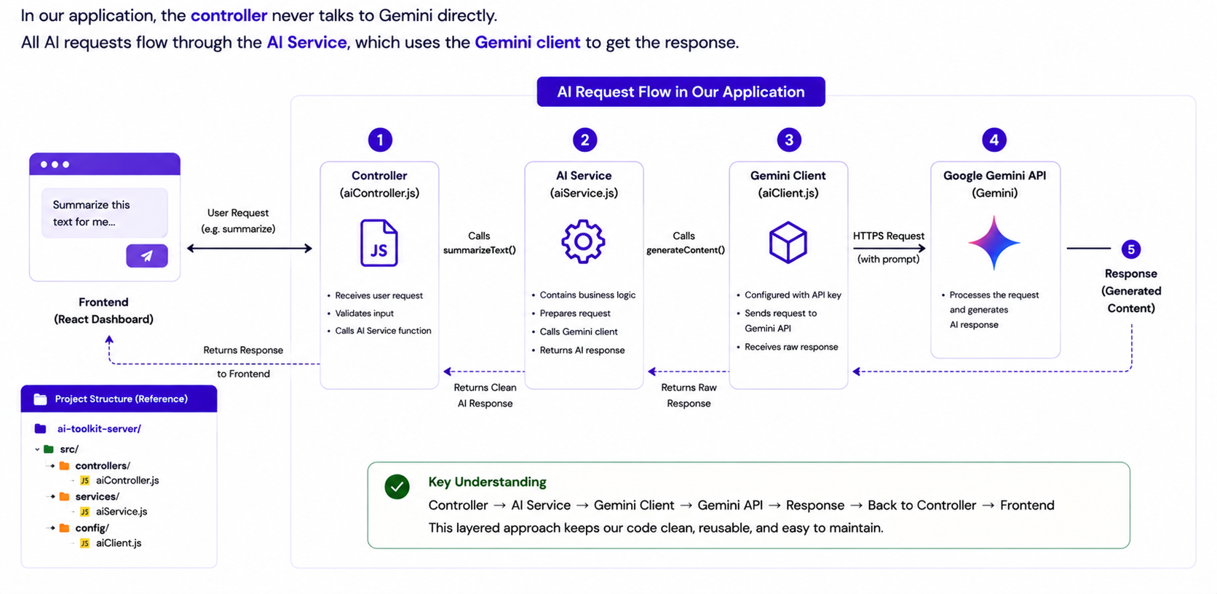
Understanding AI Requests

Slide 35
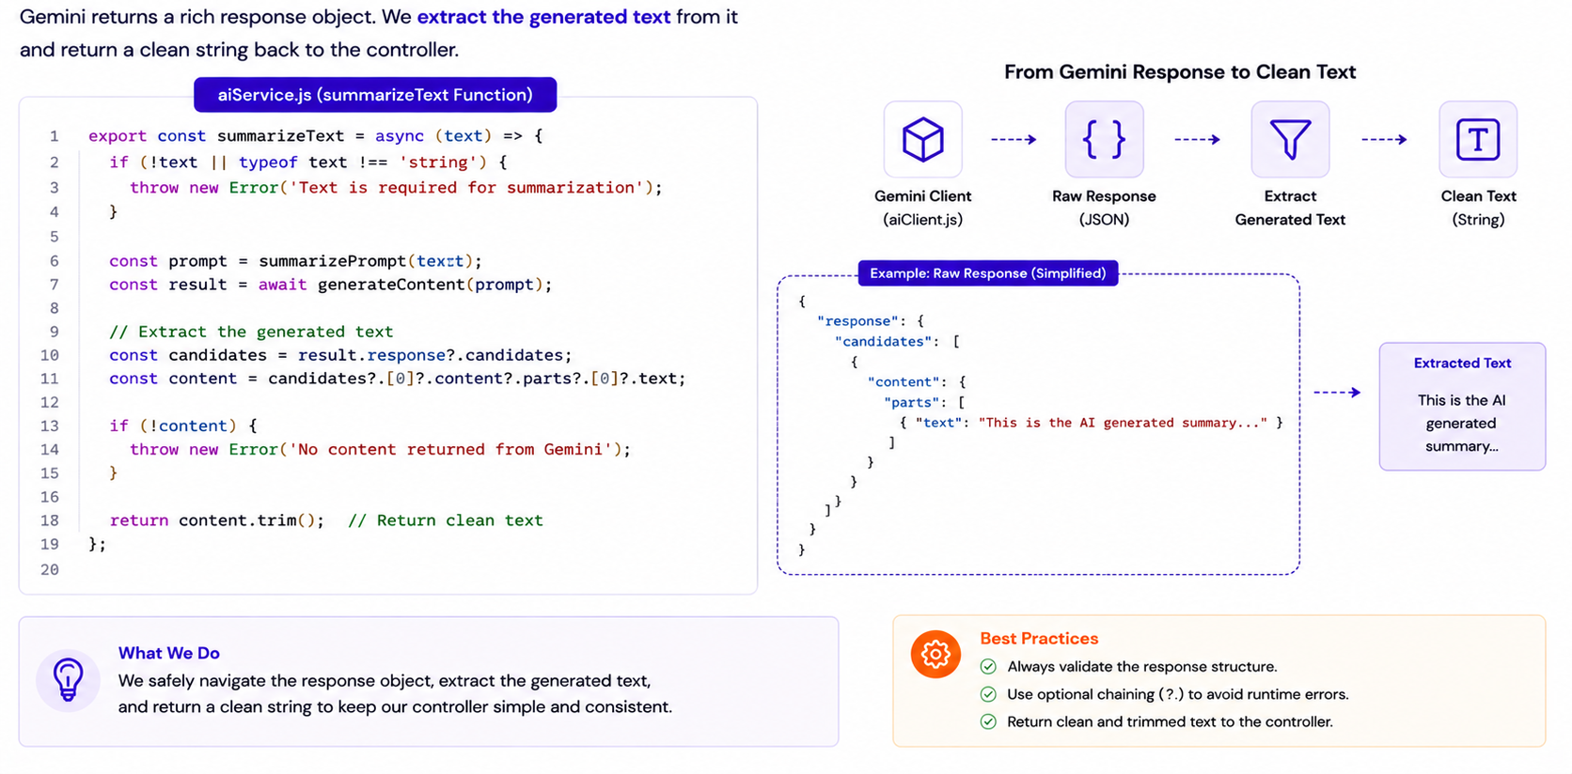
Handling AI Responses

Slide 36
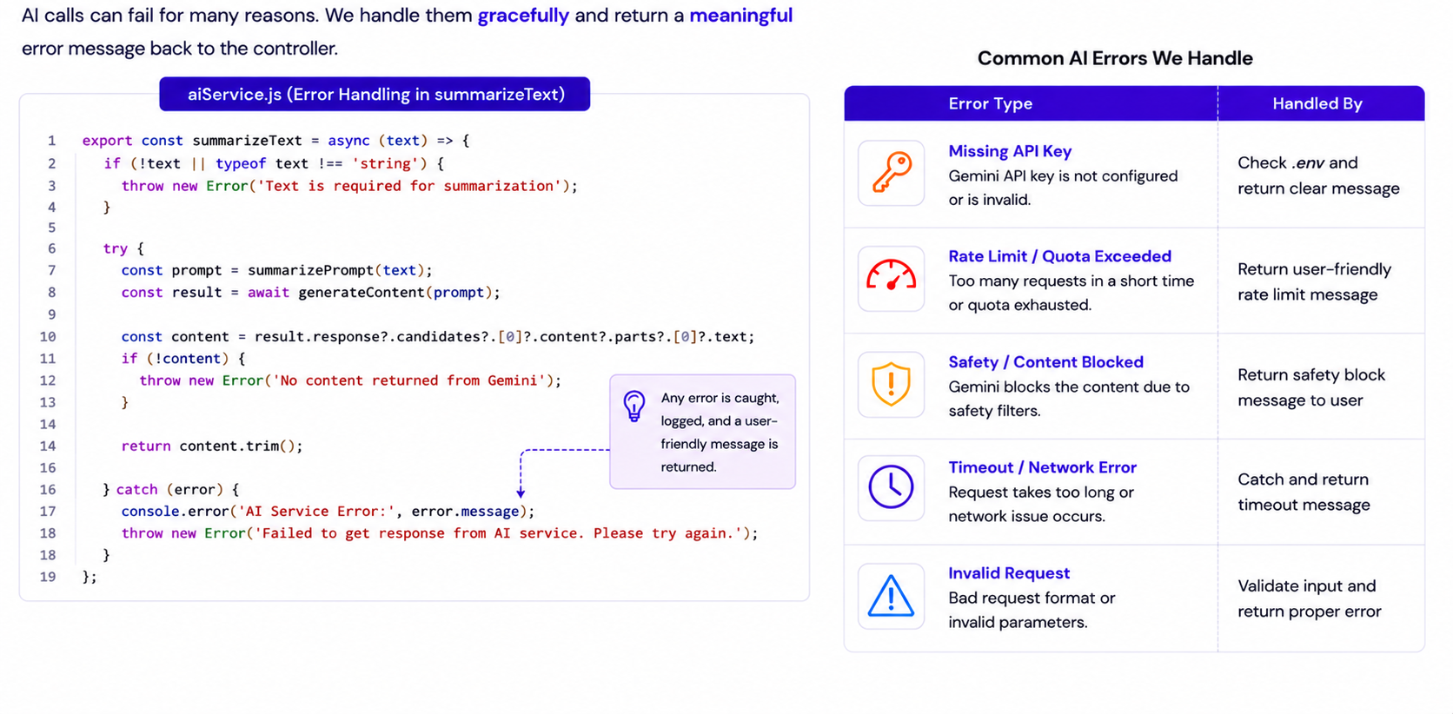
Handling Errors

Slide 37
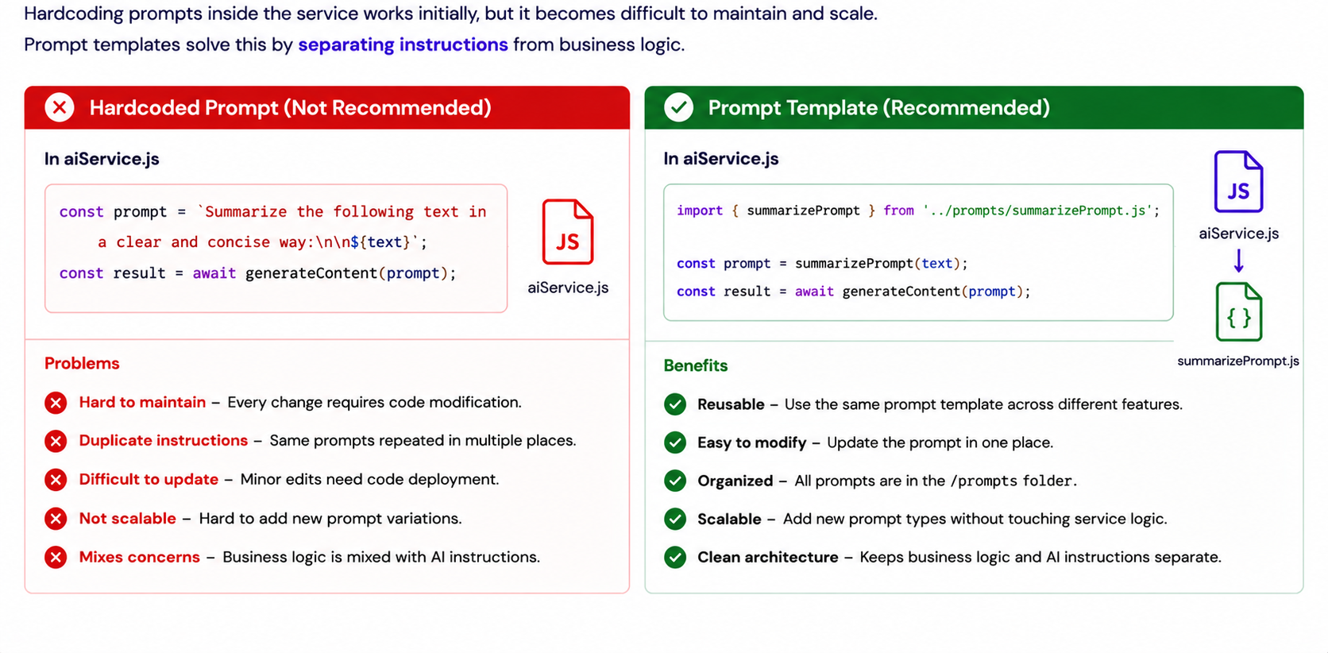
Why Prompt Templates?

Slide 38
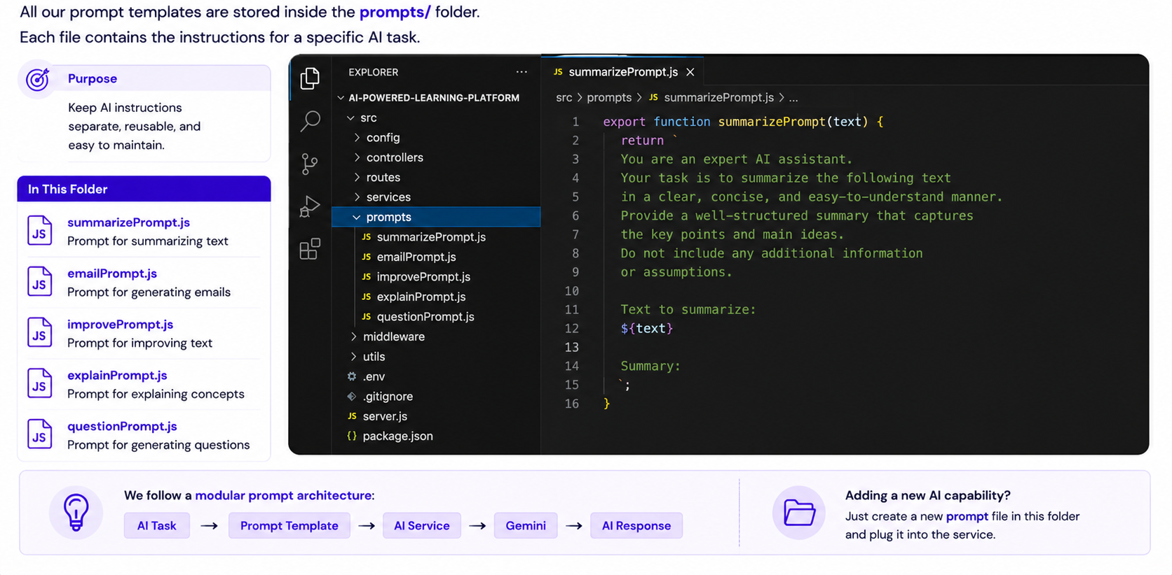
Exploring the prompts Folder

Slide 39
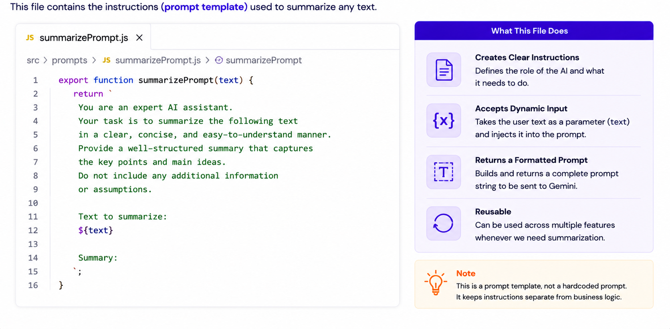
Understanding summarizePrompt.js

Slide 40
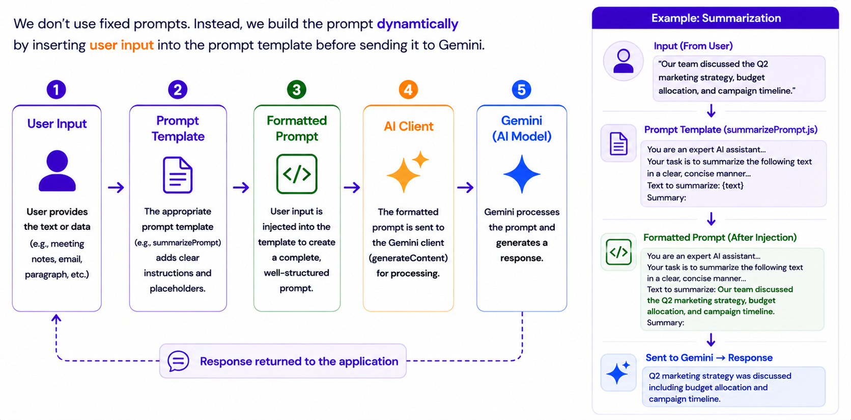
Dynamic Prompt Construction

Slide 41
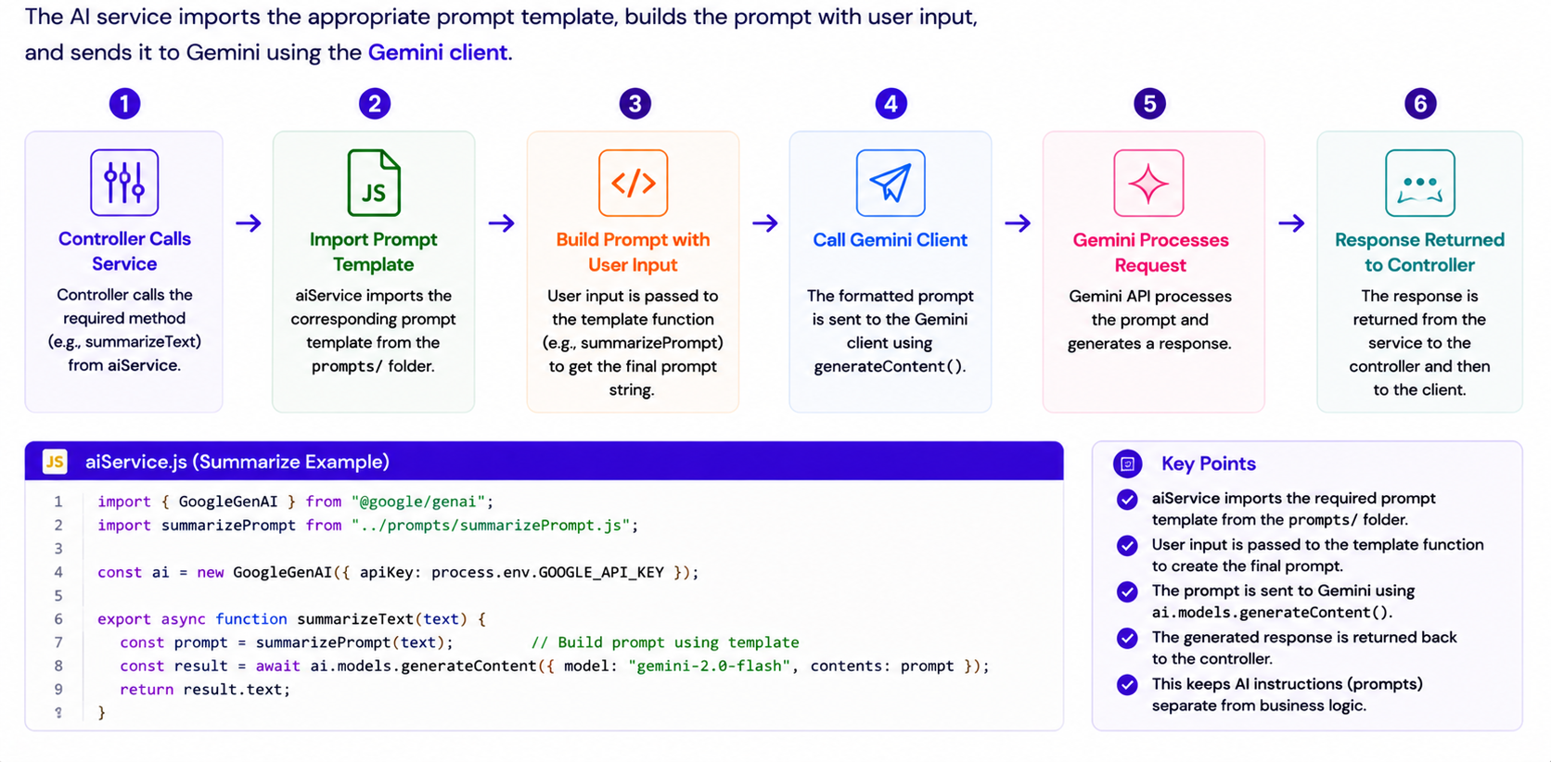
Using Prompt Templates in aiService.js

Slide 42
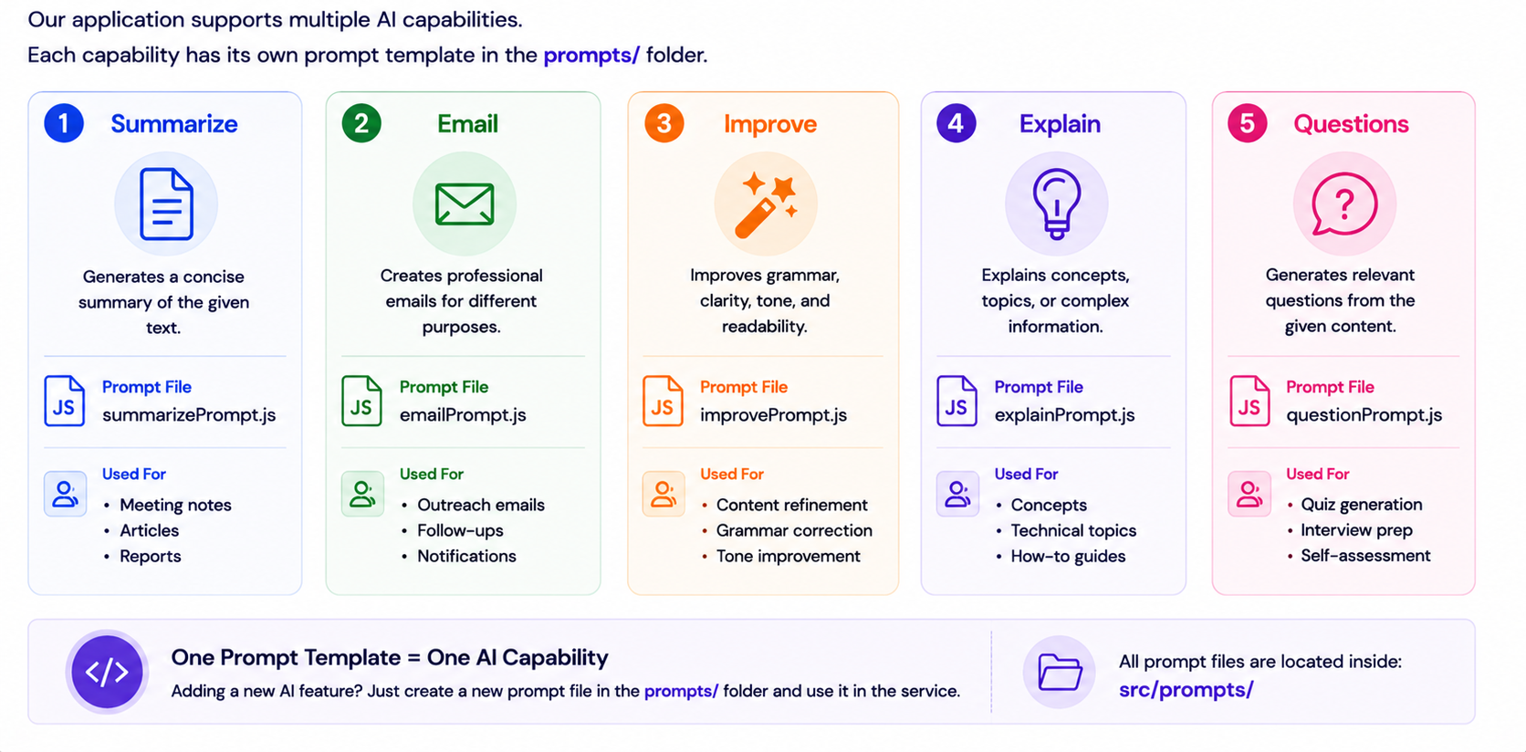
Multiple AI Tasks Using Prompt Templates

Slide 43
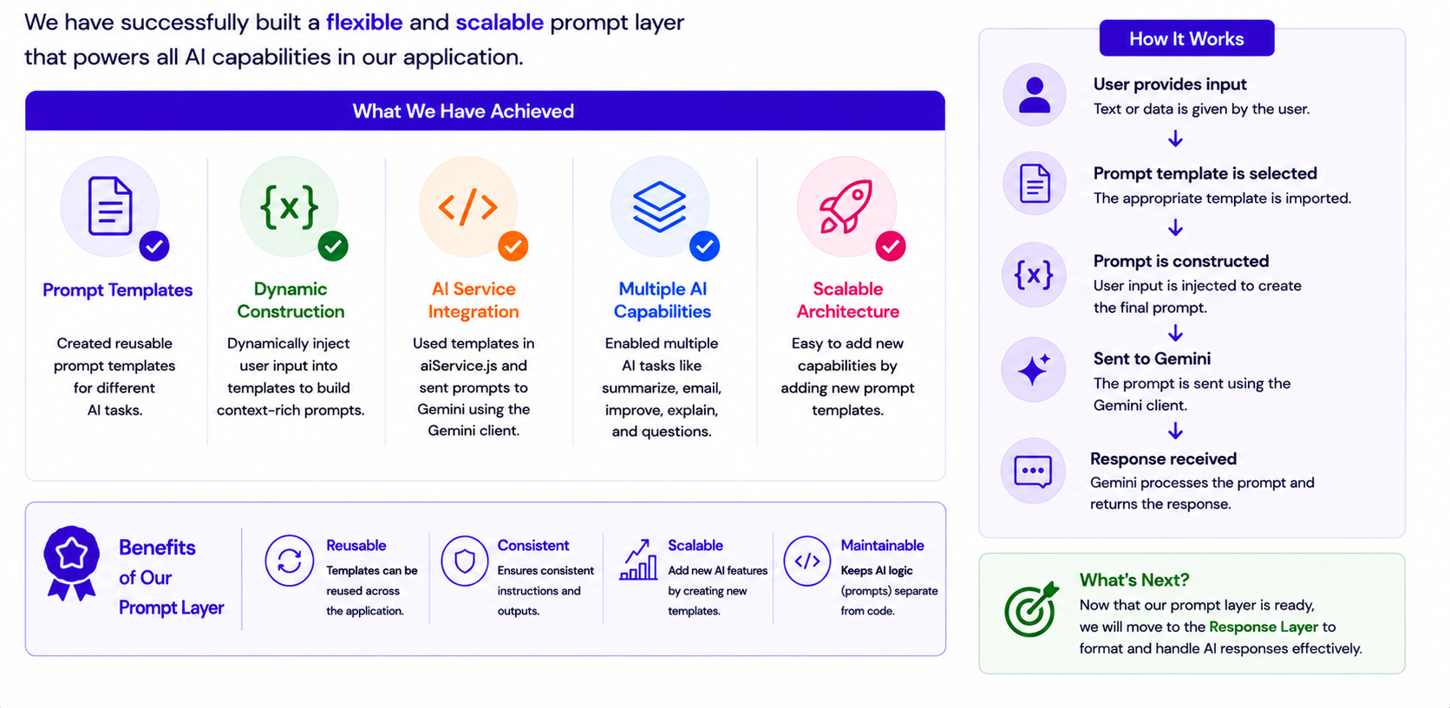
Prompt Layer Complete

Slide 44
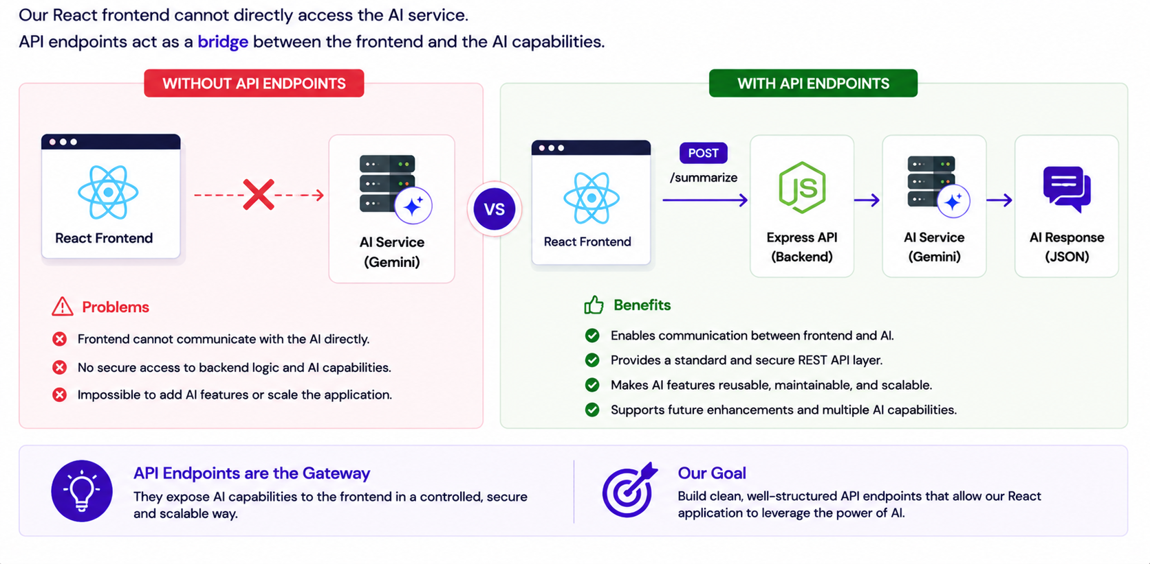
Why Do We Need API Endpoints?

Slide 45
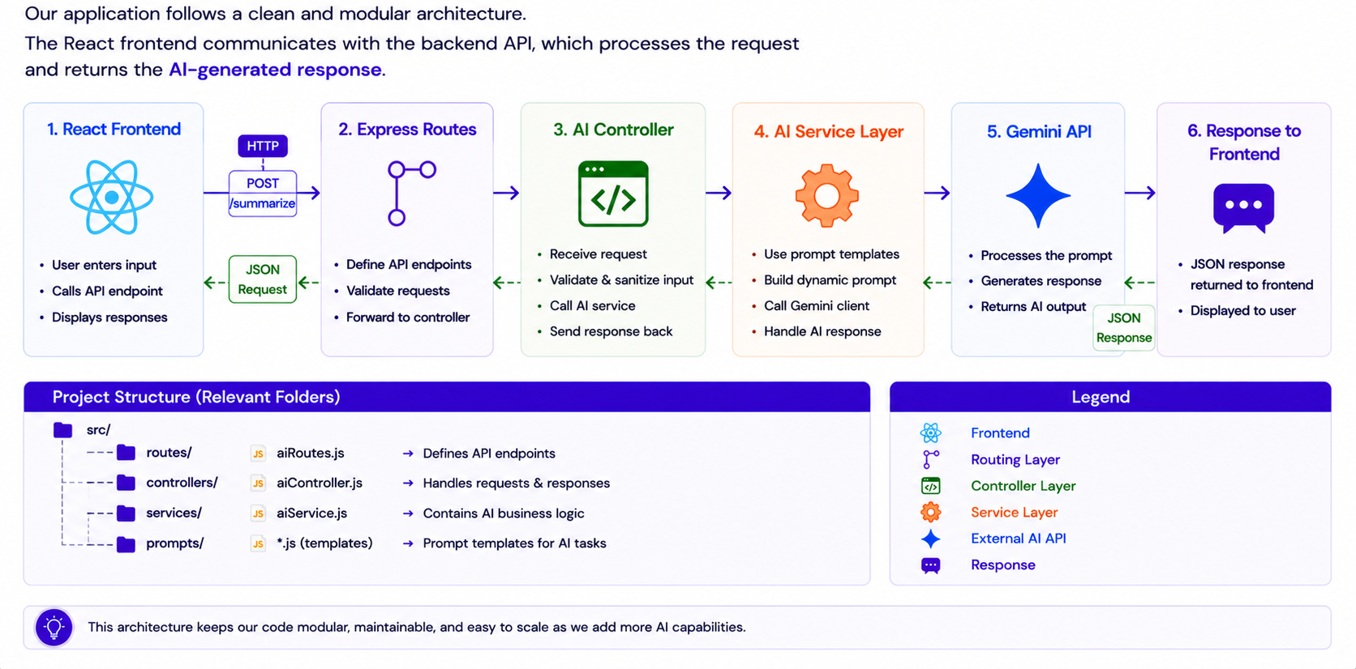
Understanding the API Architecture

Slide 46
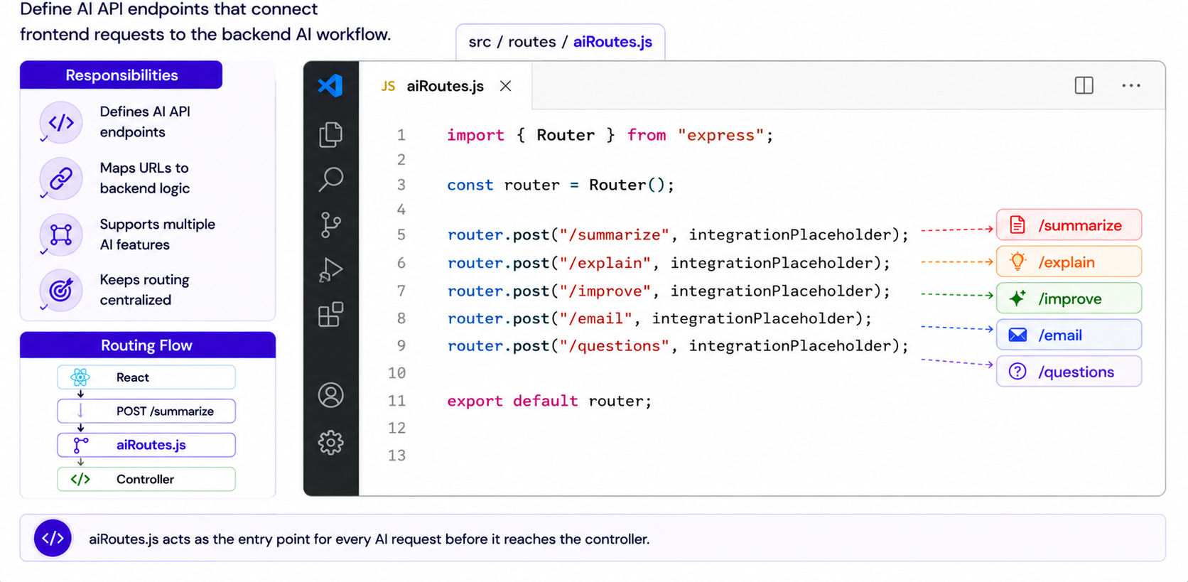
Exploring aiRoutes.js

Slide 47
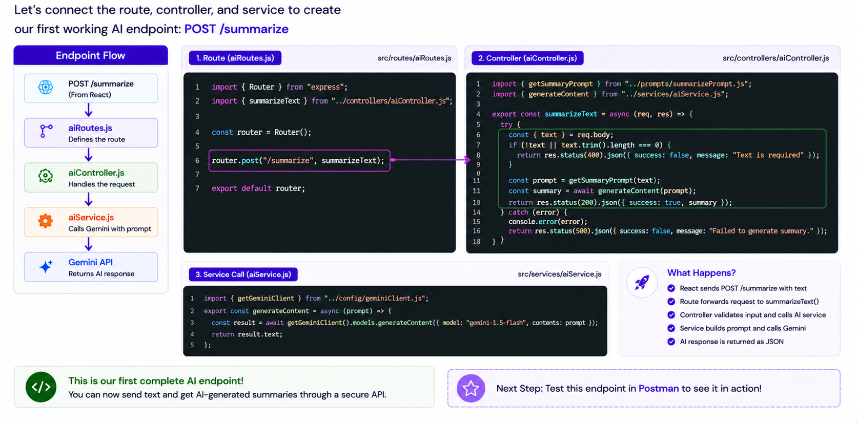
Building AI Endpoints

Slide 48
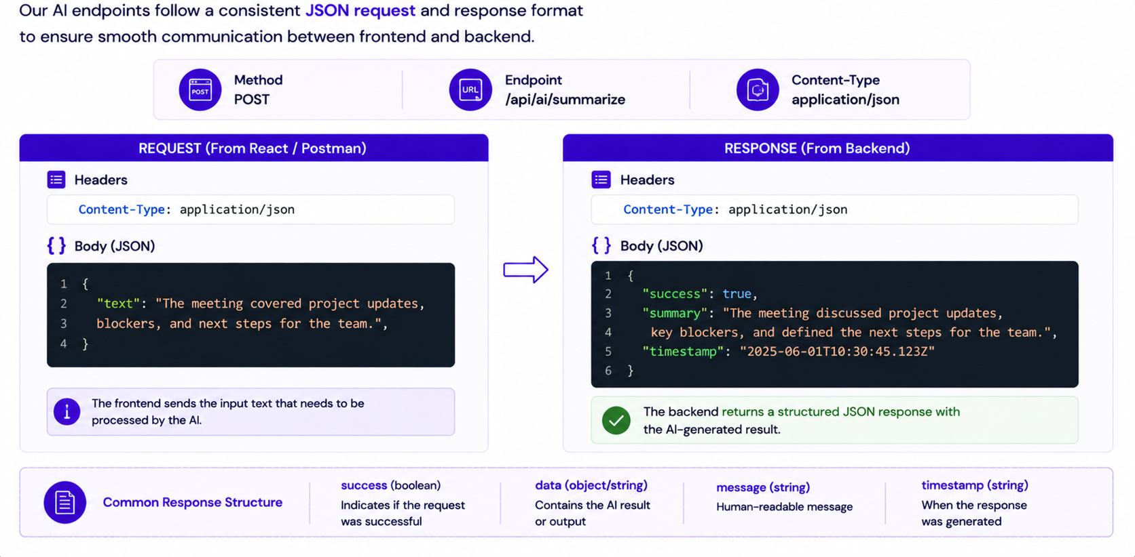
Request and Response Structure

Slide 49
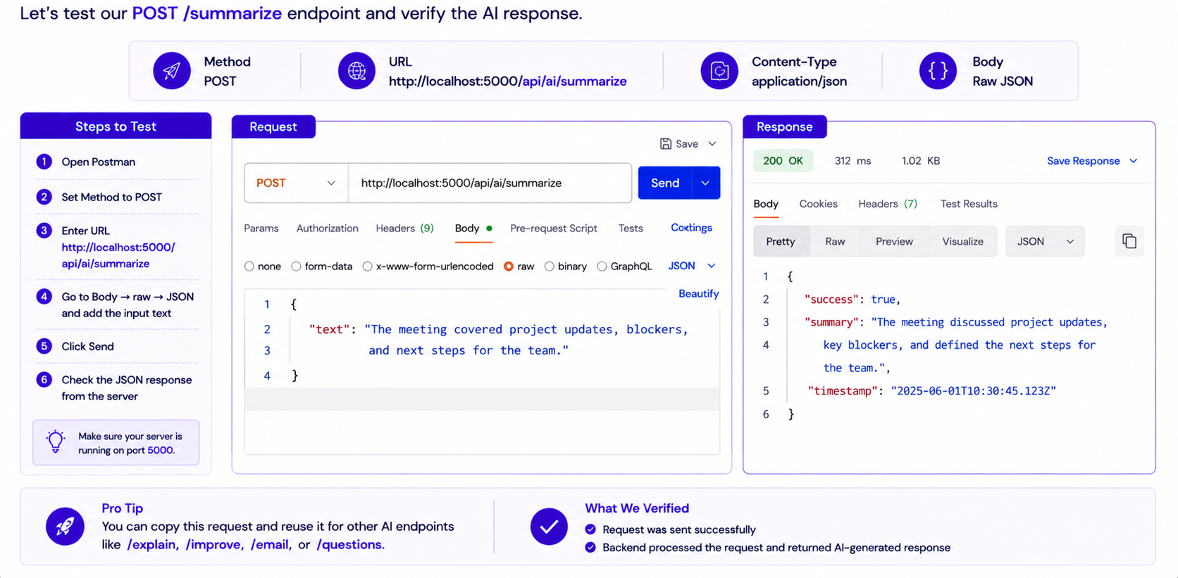
Testing the Endpoint in Postman

Slide 50
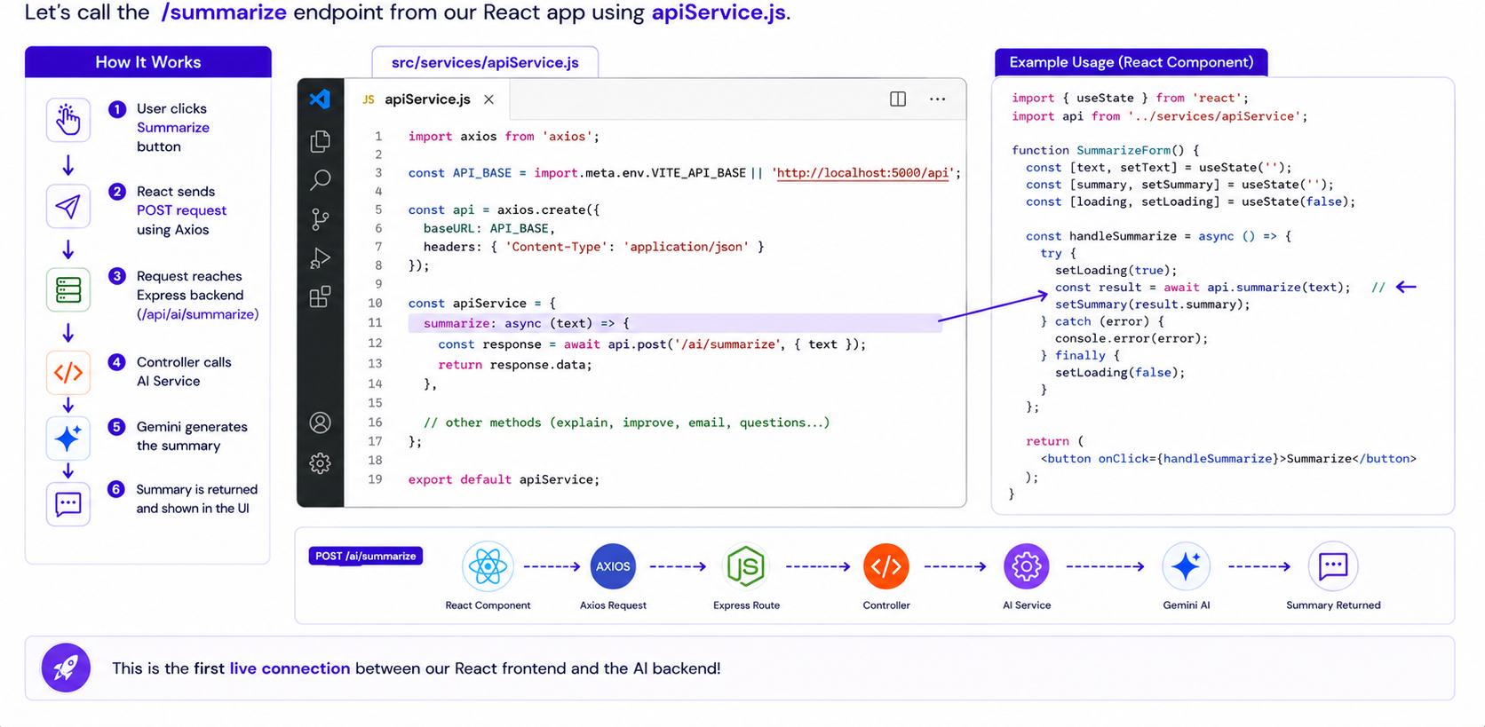
Calling AI Endpoints from React

Slide 51
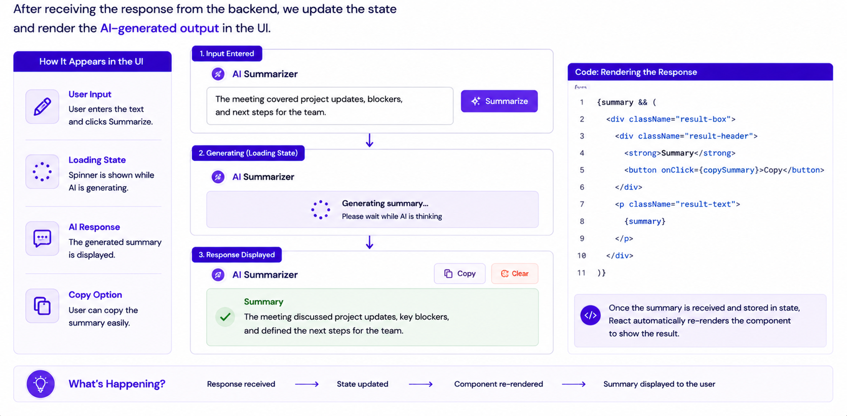
Displaying AI Responses in React

Slide 52
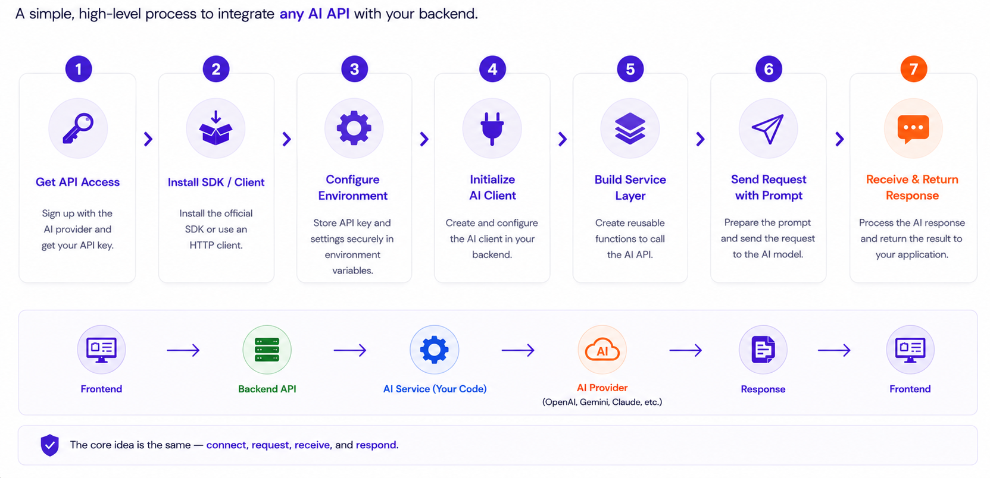
Generic API Integration Process

Slide 53


